Slide 1
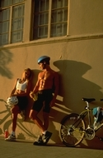



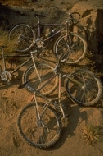
Product Catalog

Slide 2
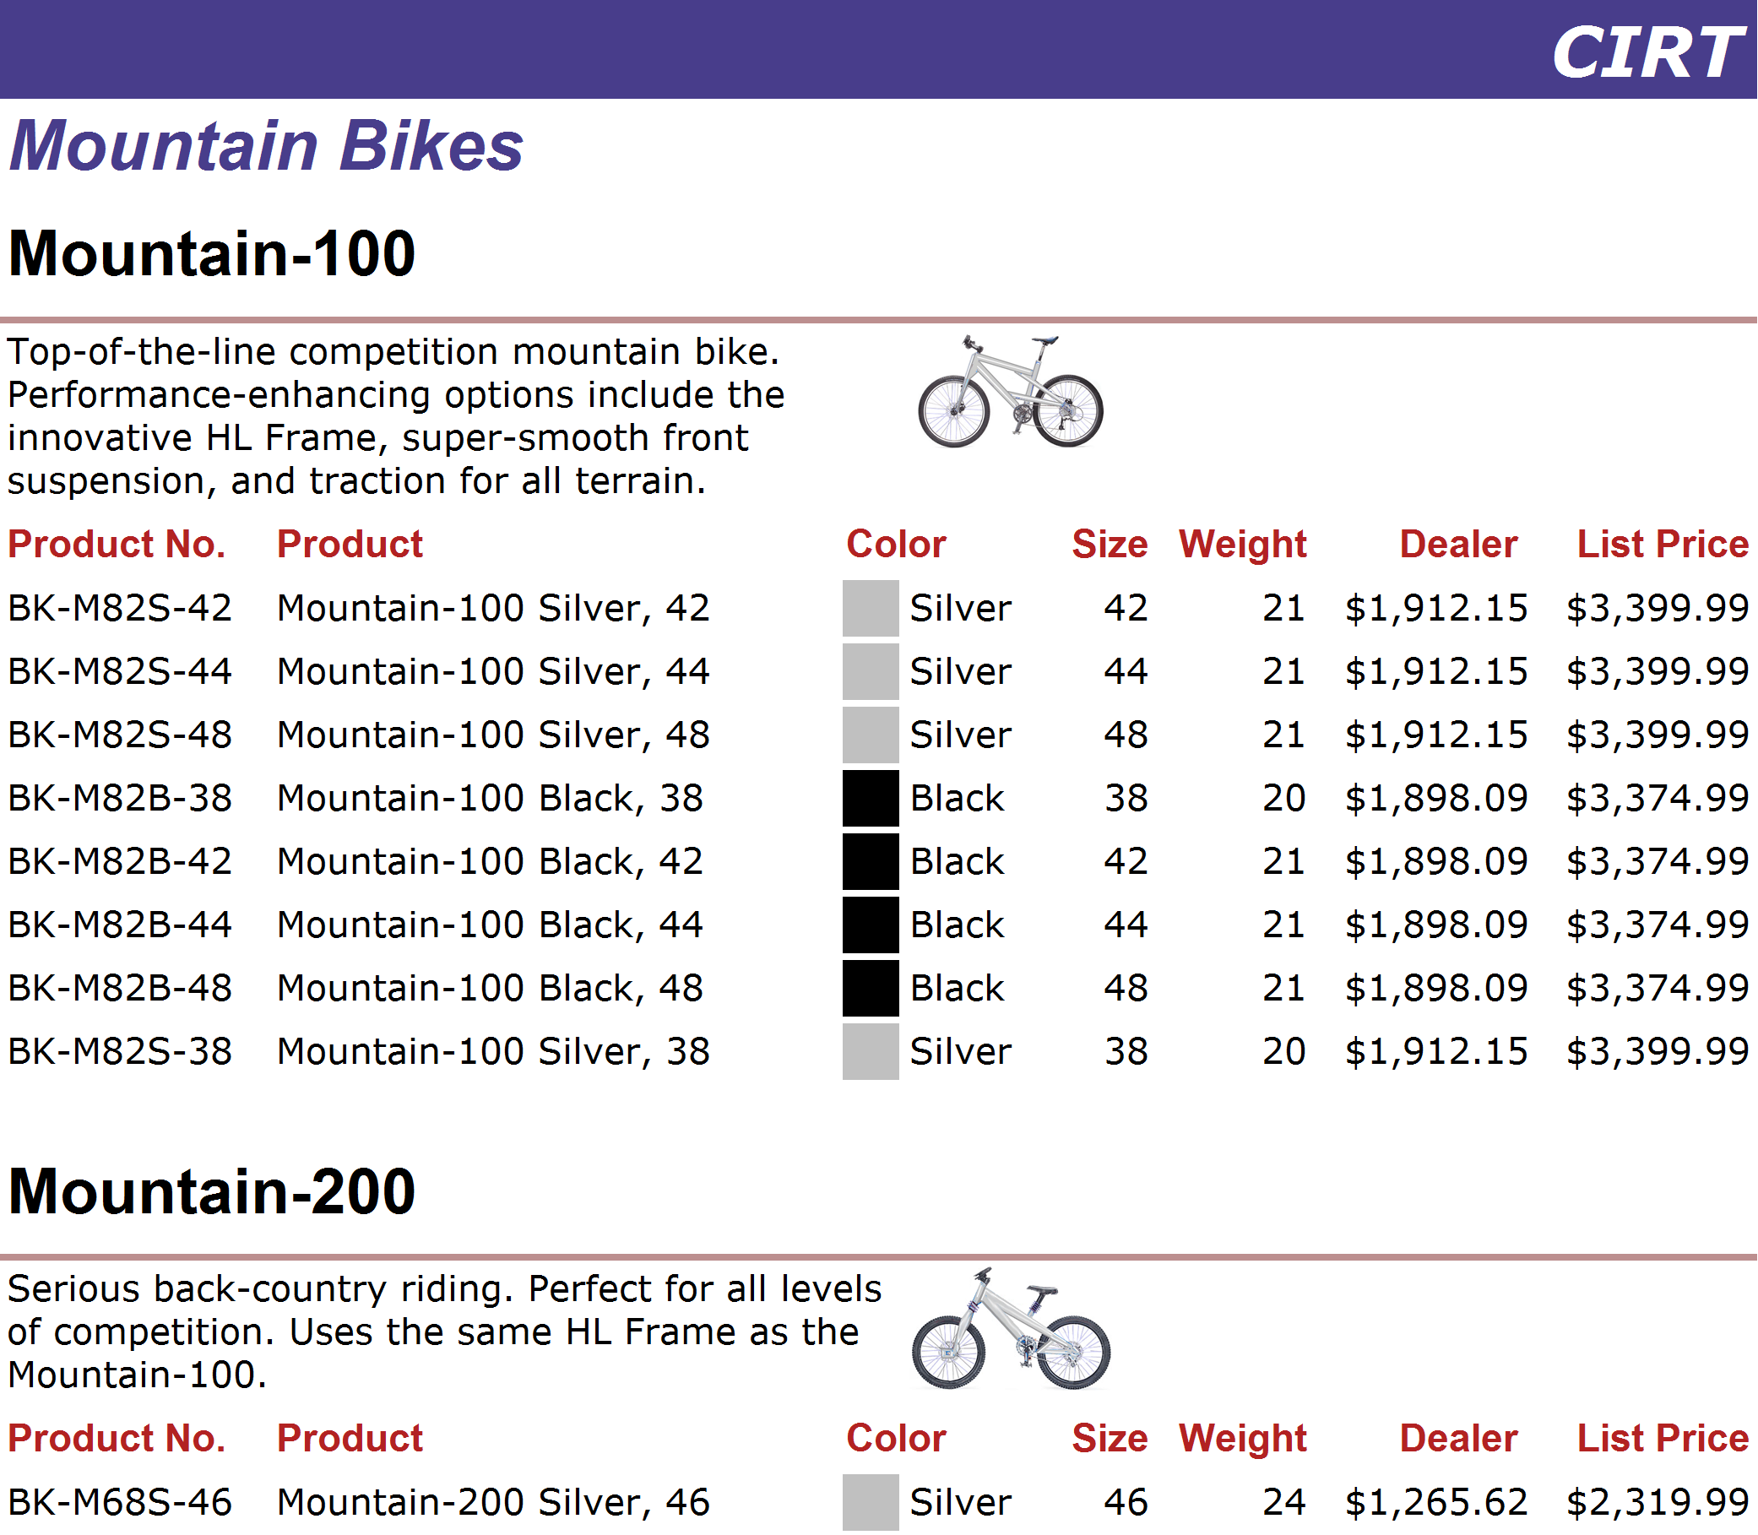
http://www.adventure-works.com
Page 2

Slide 3
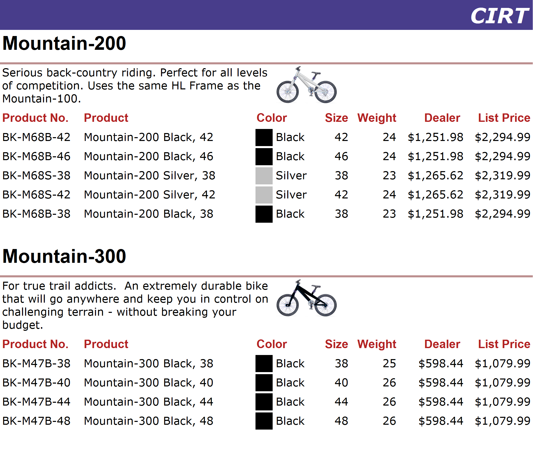
http://www.adventure-works.com
Page 3

Slide 4
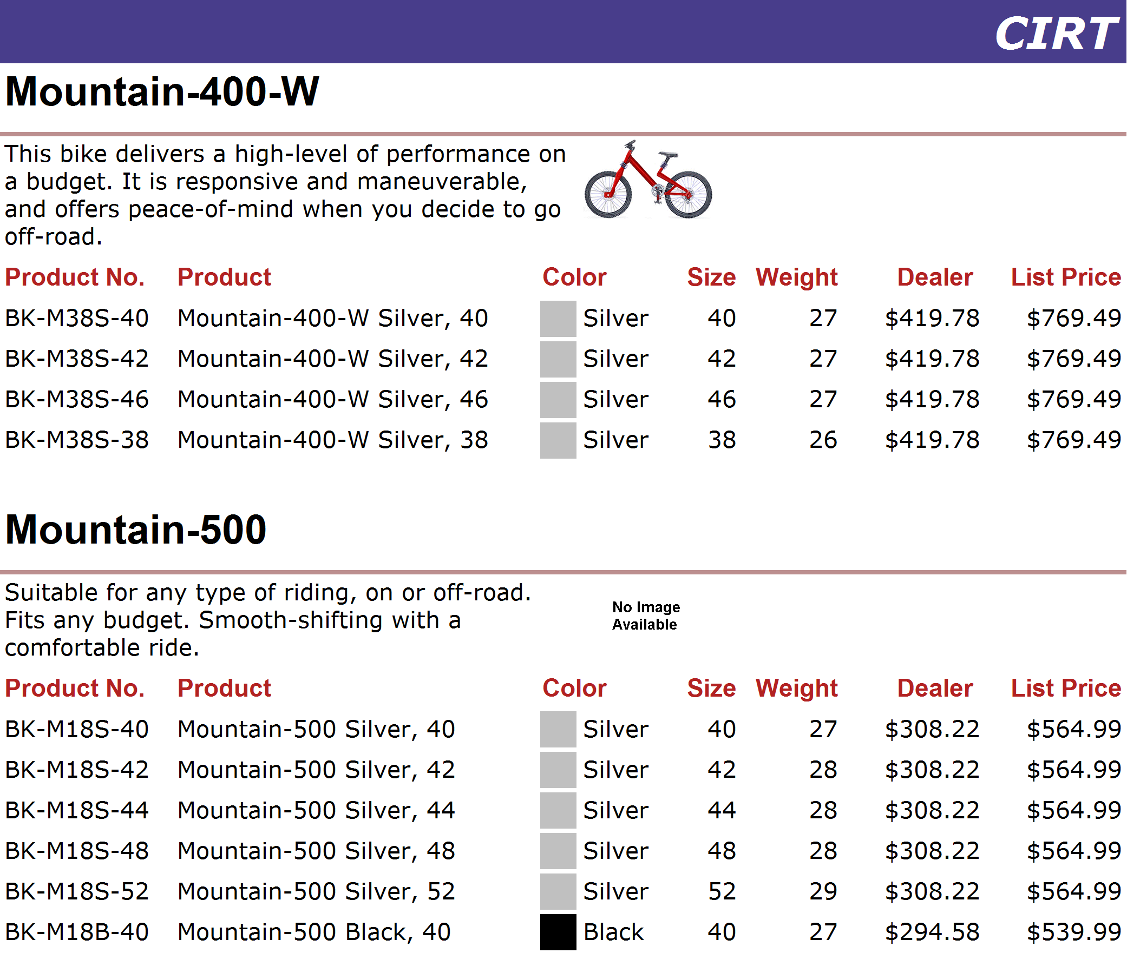
http://www.adventure-works.com
Page 4

Slide 5
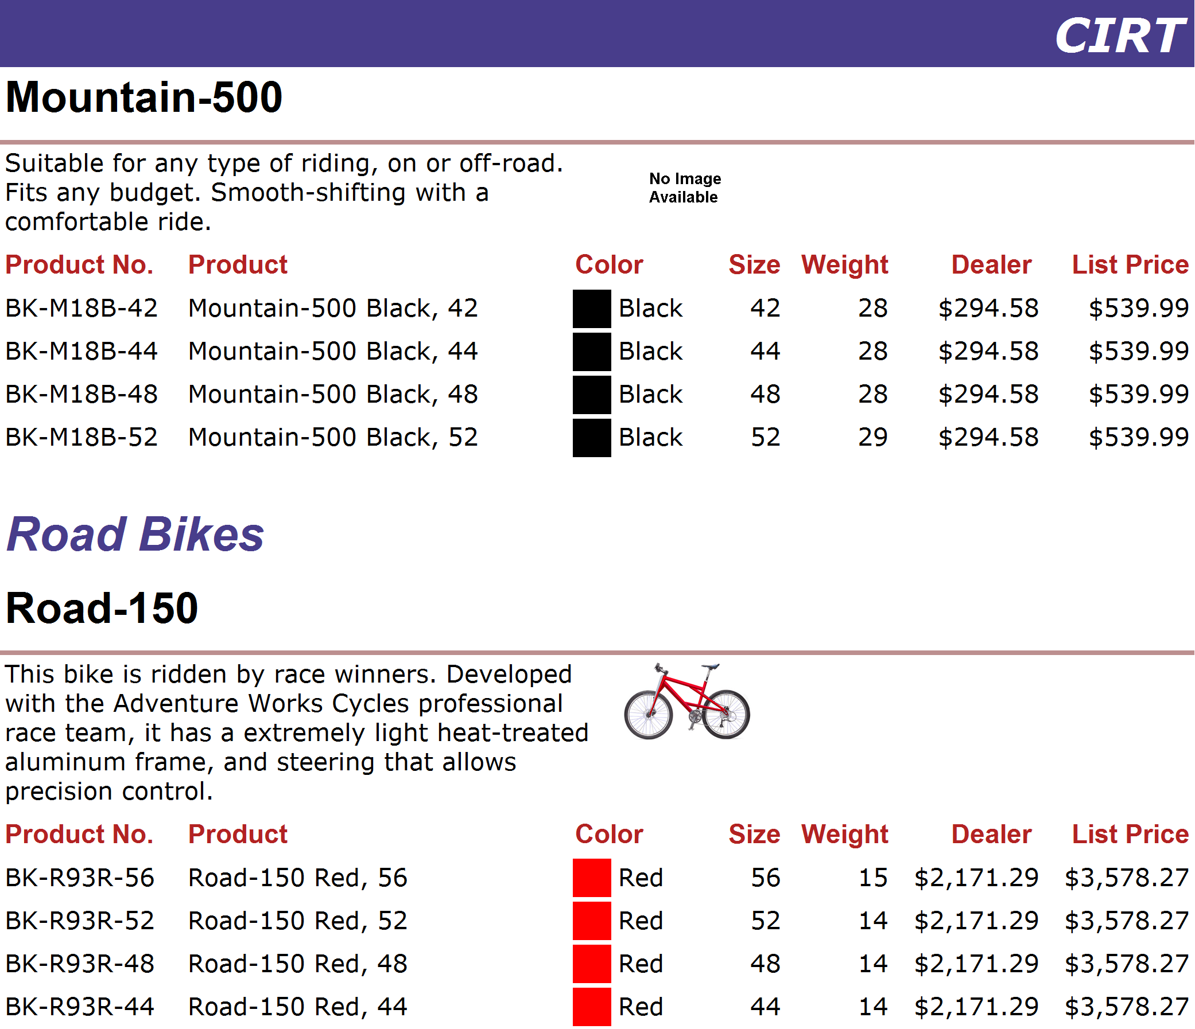
http://www.adventure-works.com
Page 5

Slide 6
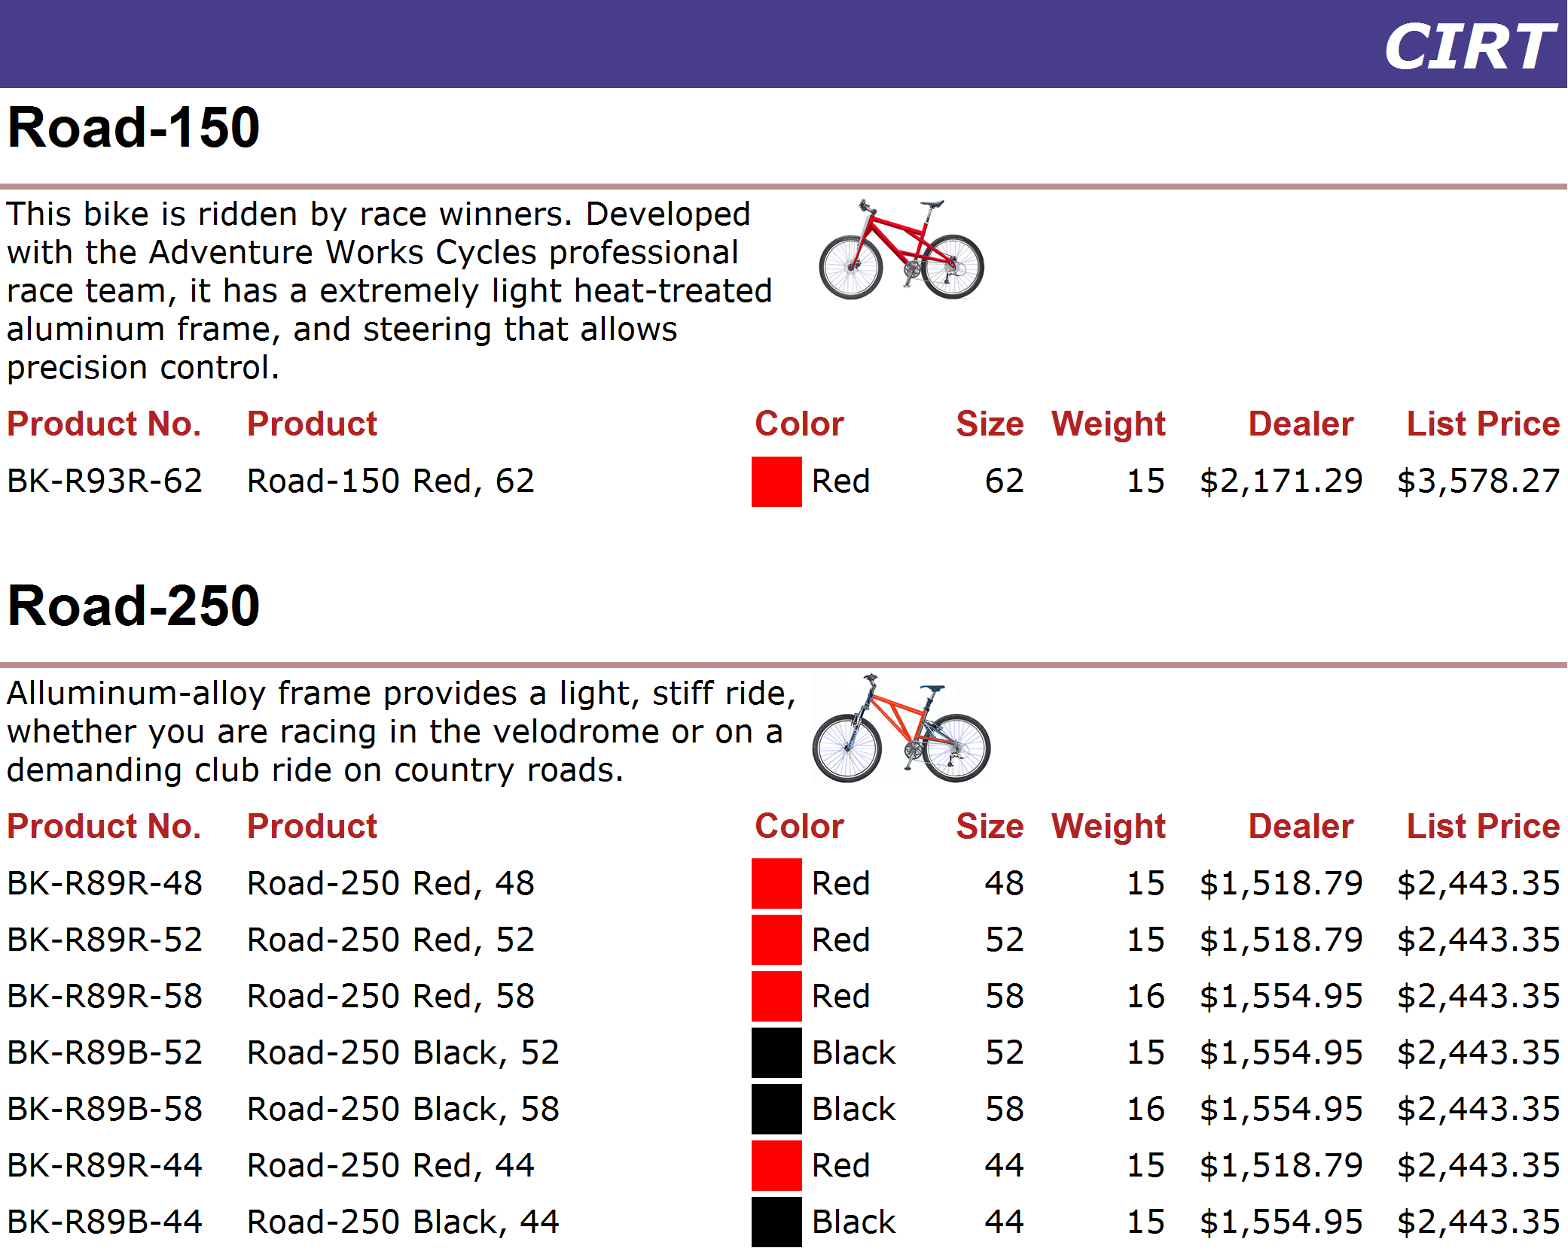
http://www.adventure-works.com
Page 6

Slide 7
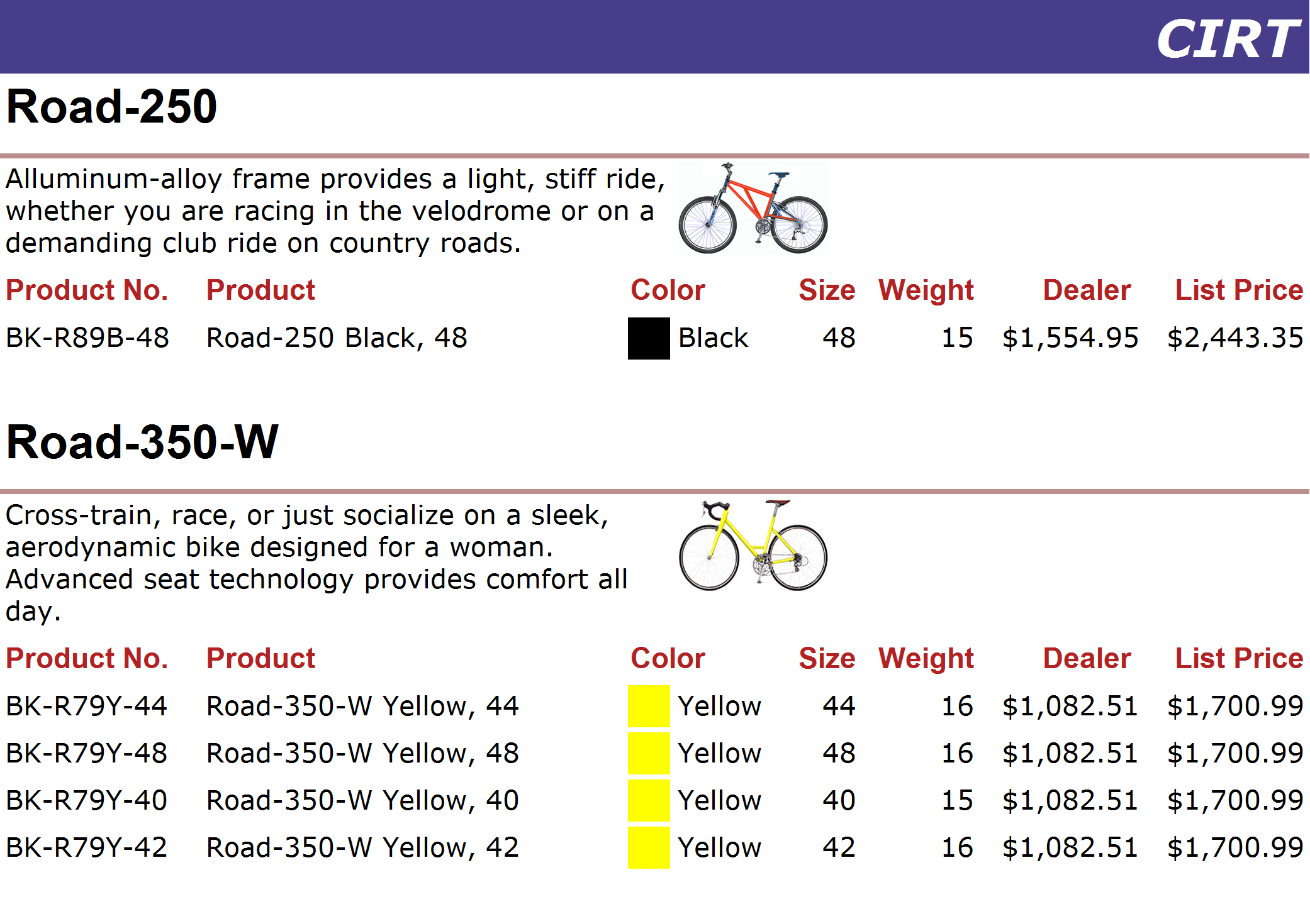
http://www.adventure-works.com
Page 7

Slide 8
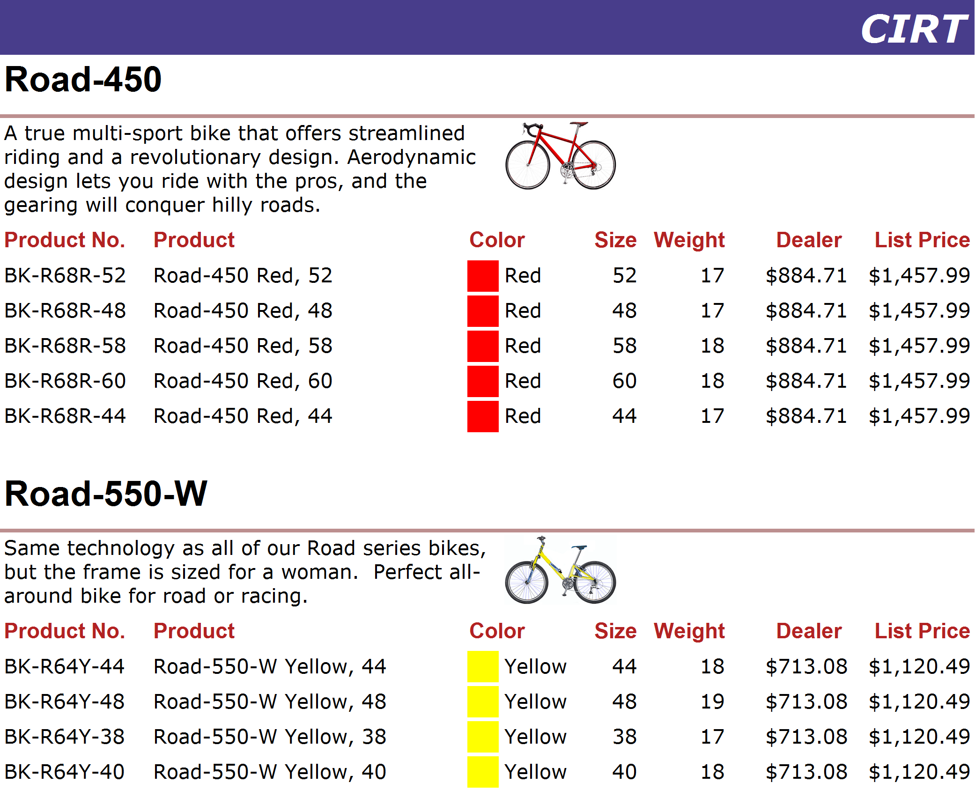
http://www.adventure-works.com
Page 8

Slide 9
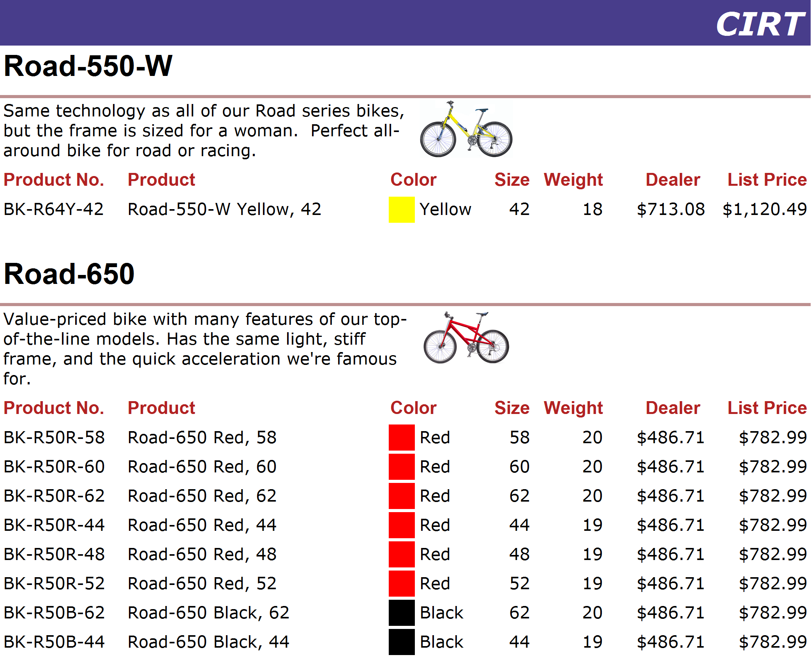
http://www.adventure-works.com
Page 9

Slide 10
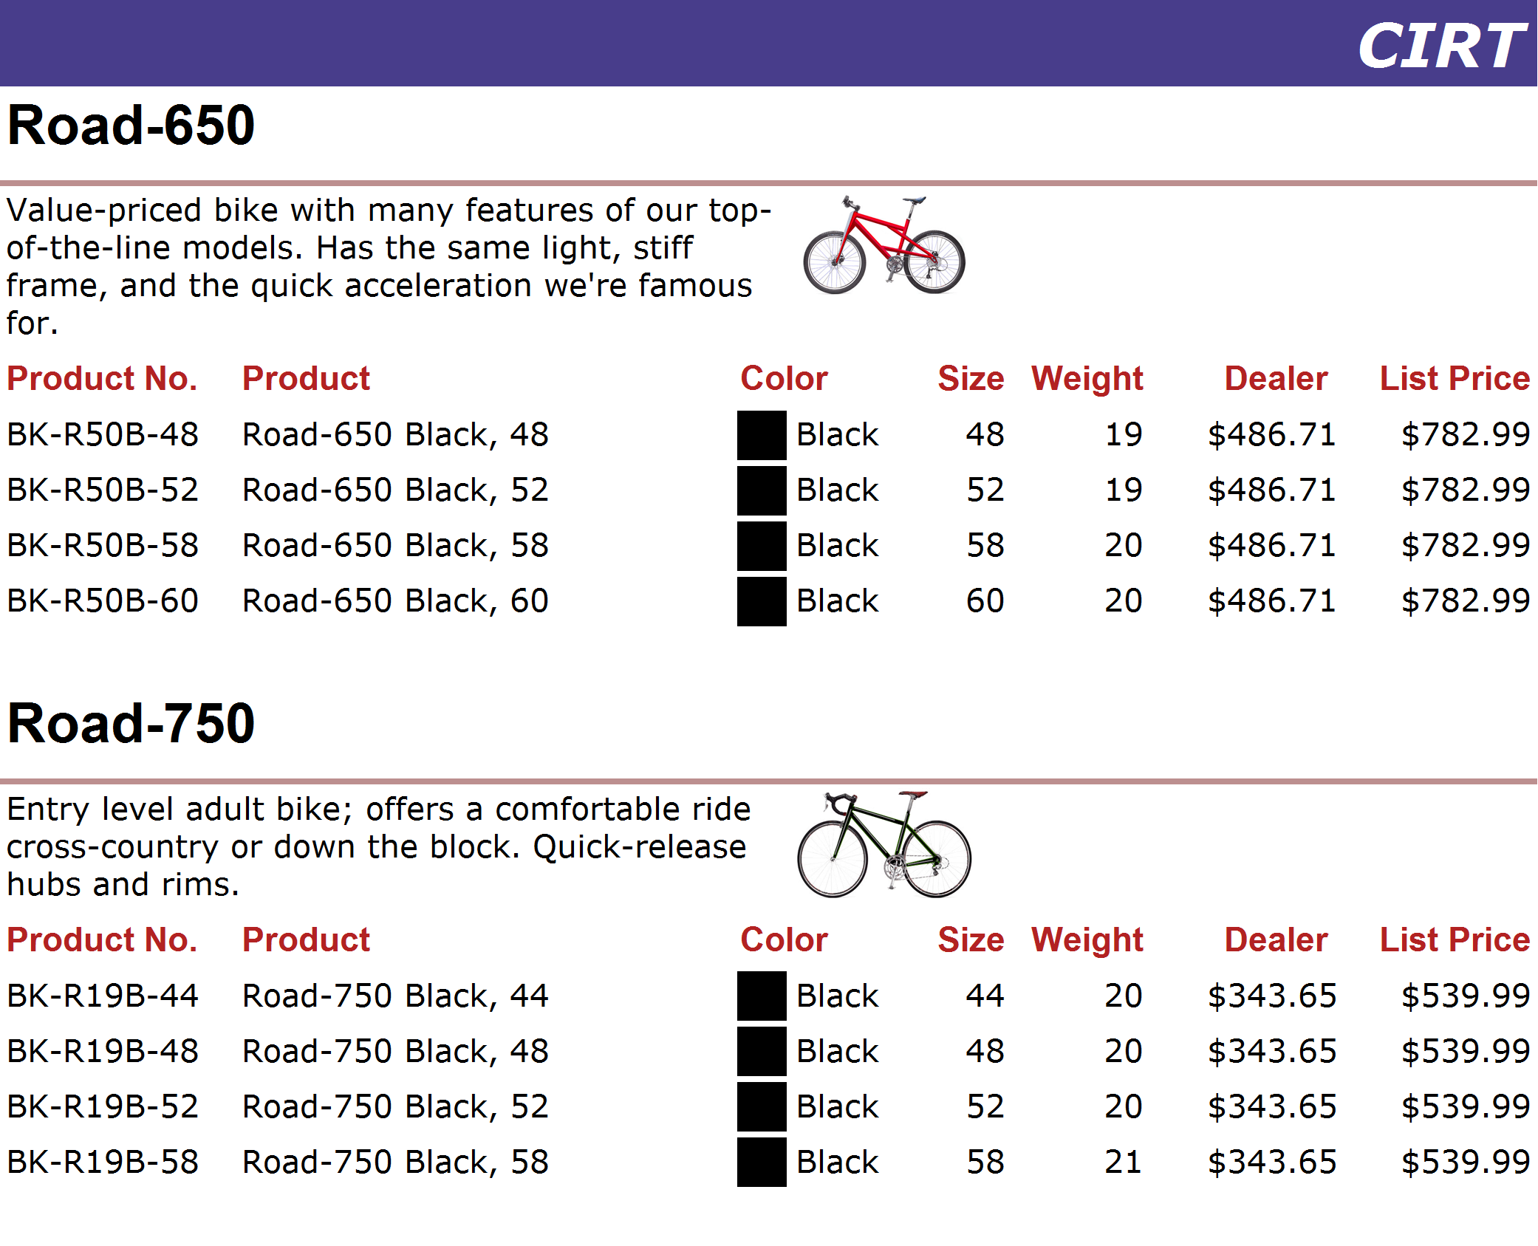
http://www.adventure-works.com
Page 10

Slide 11
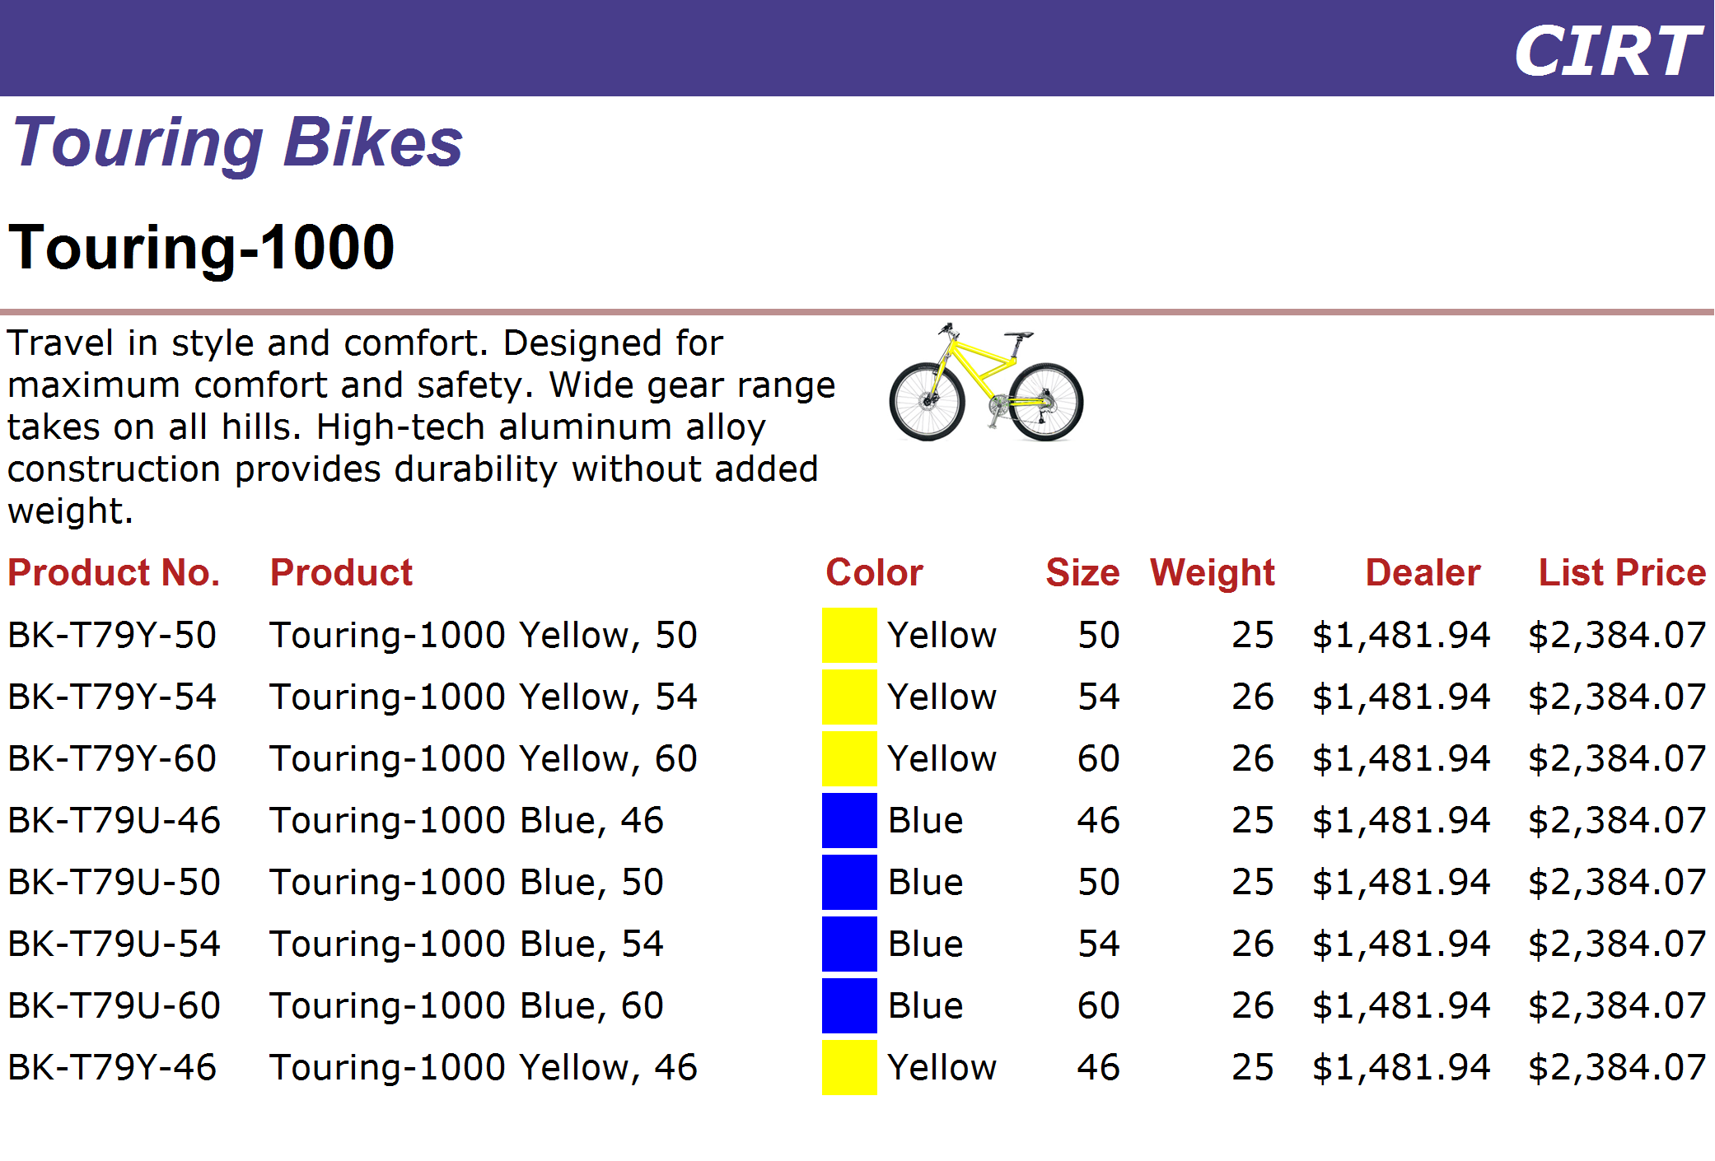
http://www.adventure-works.com
Page 11

Slide 12
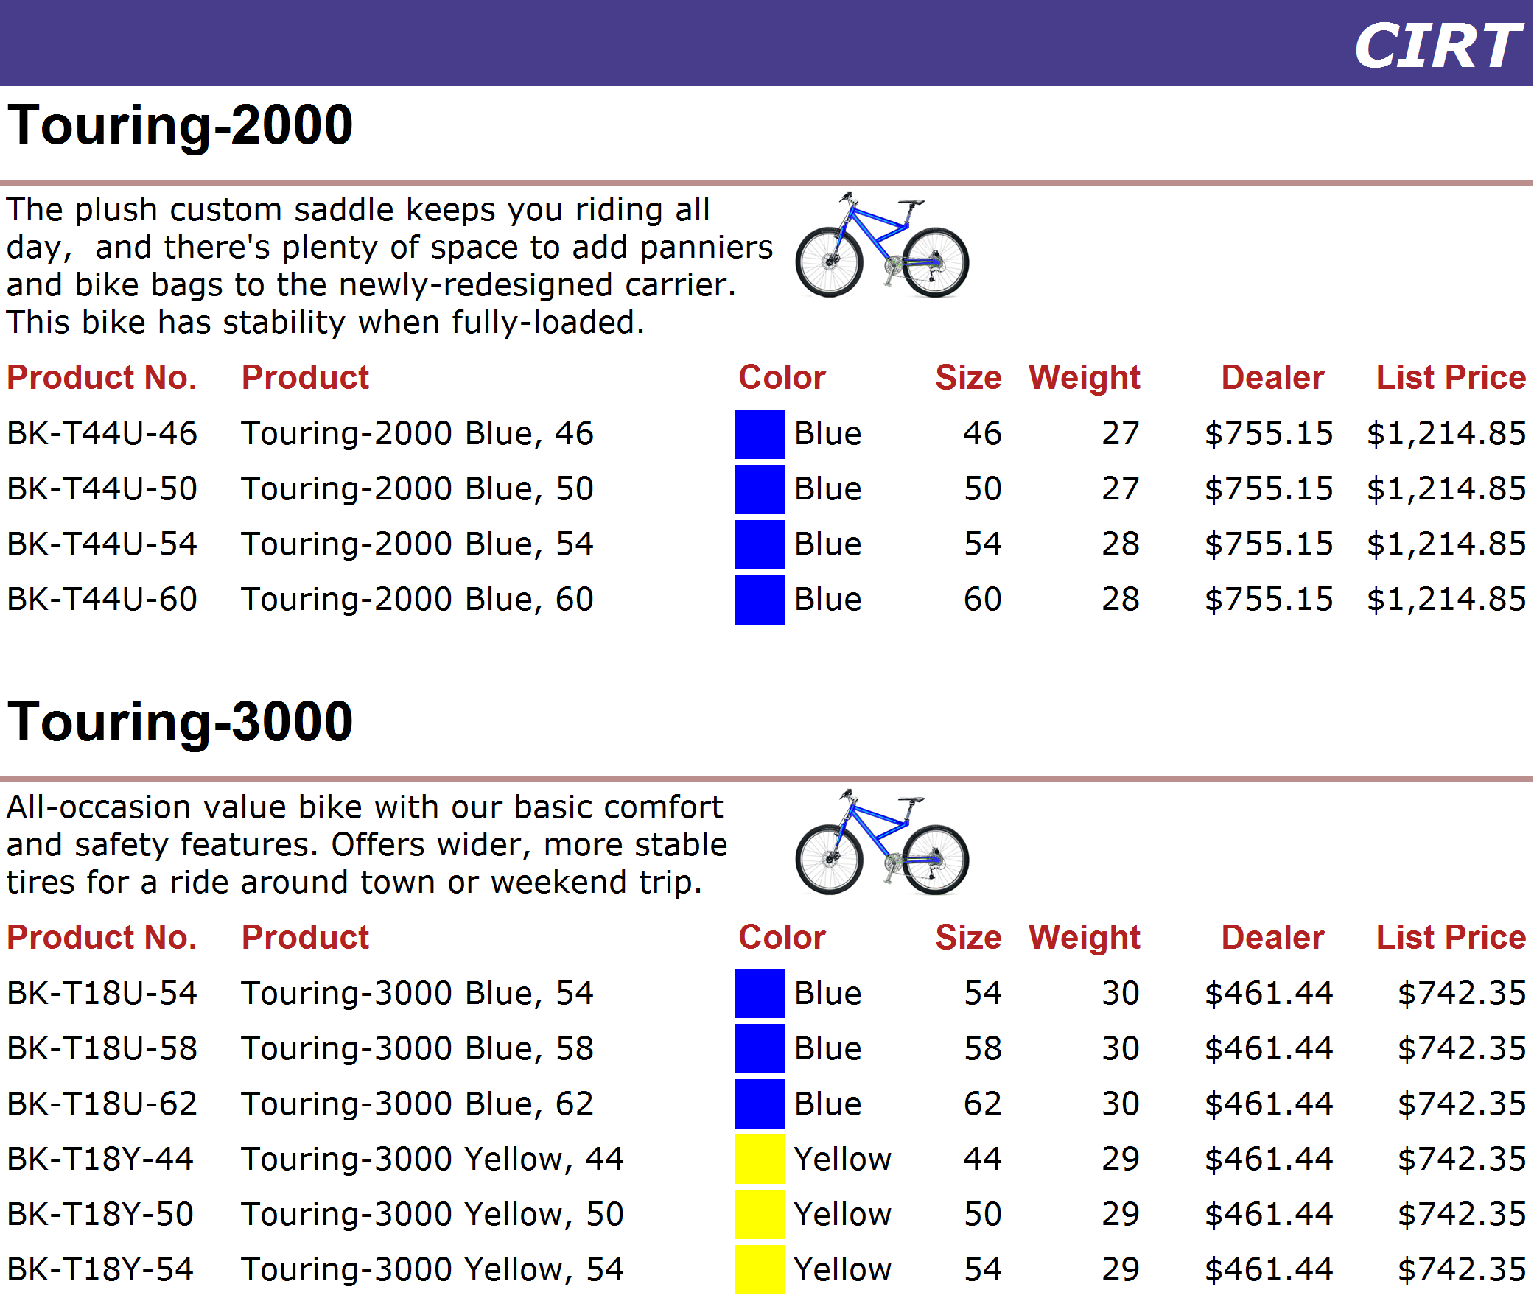
http://www.adventure-works.com
Page 12

Slide 13
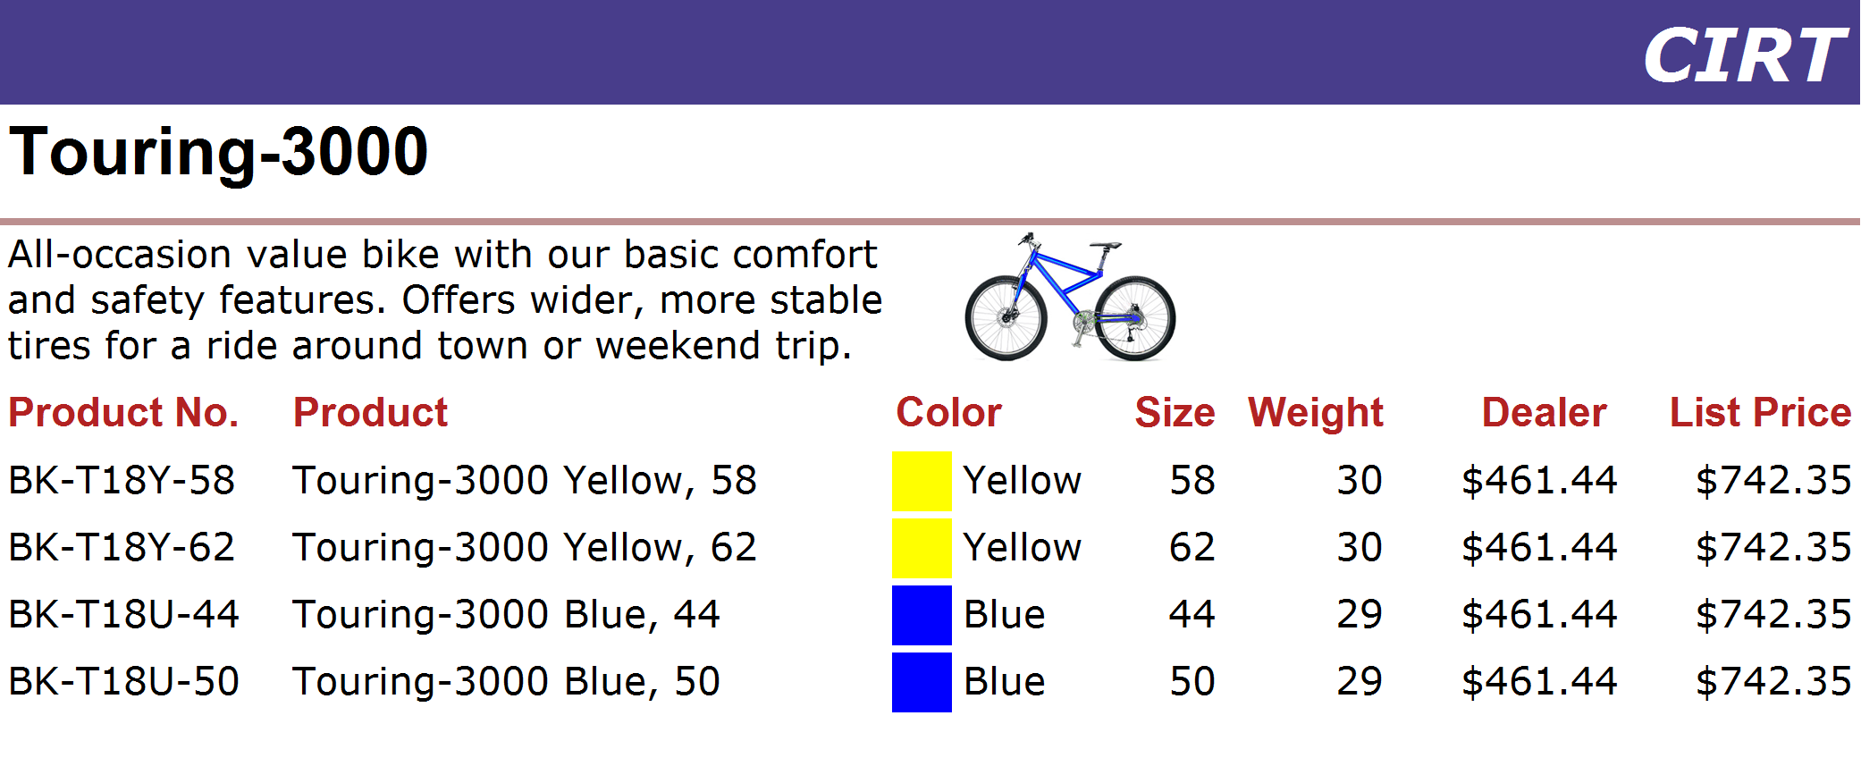
http://www.adventure-works.com
Page 13

Slide 14
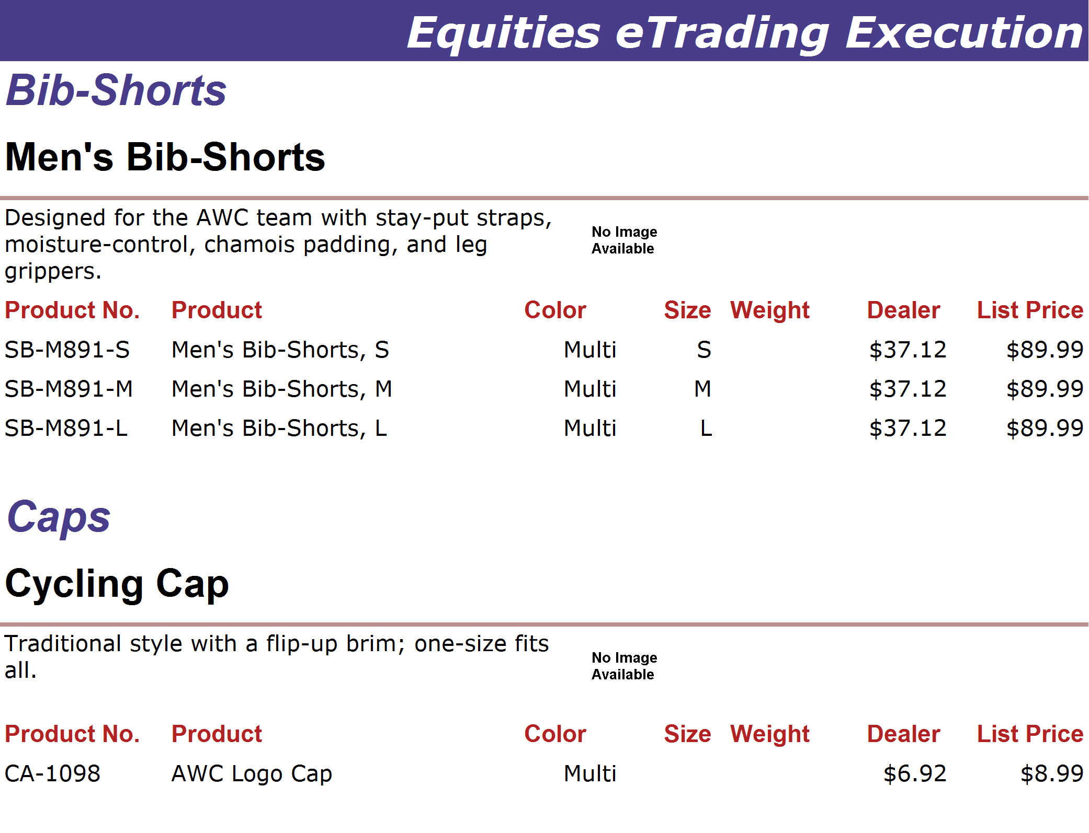
http://www.adventure-works.com
Page 14

Slide 15
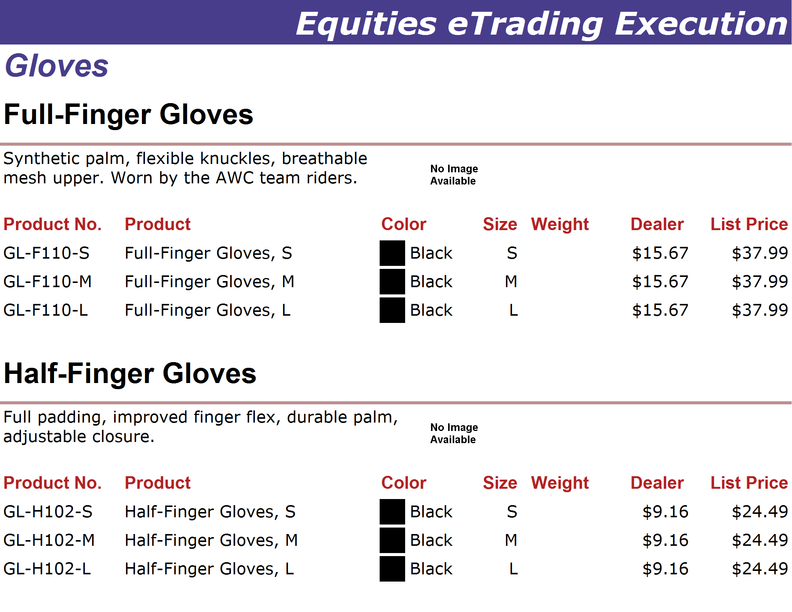
http://www.adventure-works.com
Page 15

Slide 16
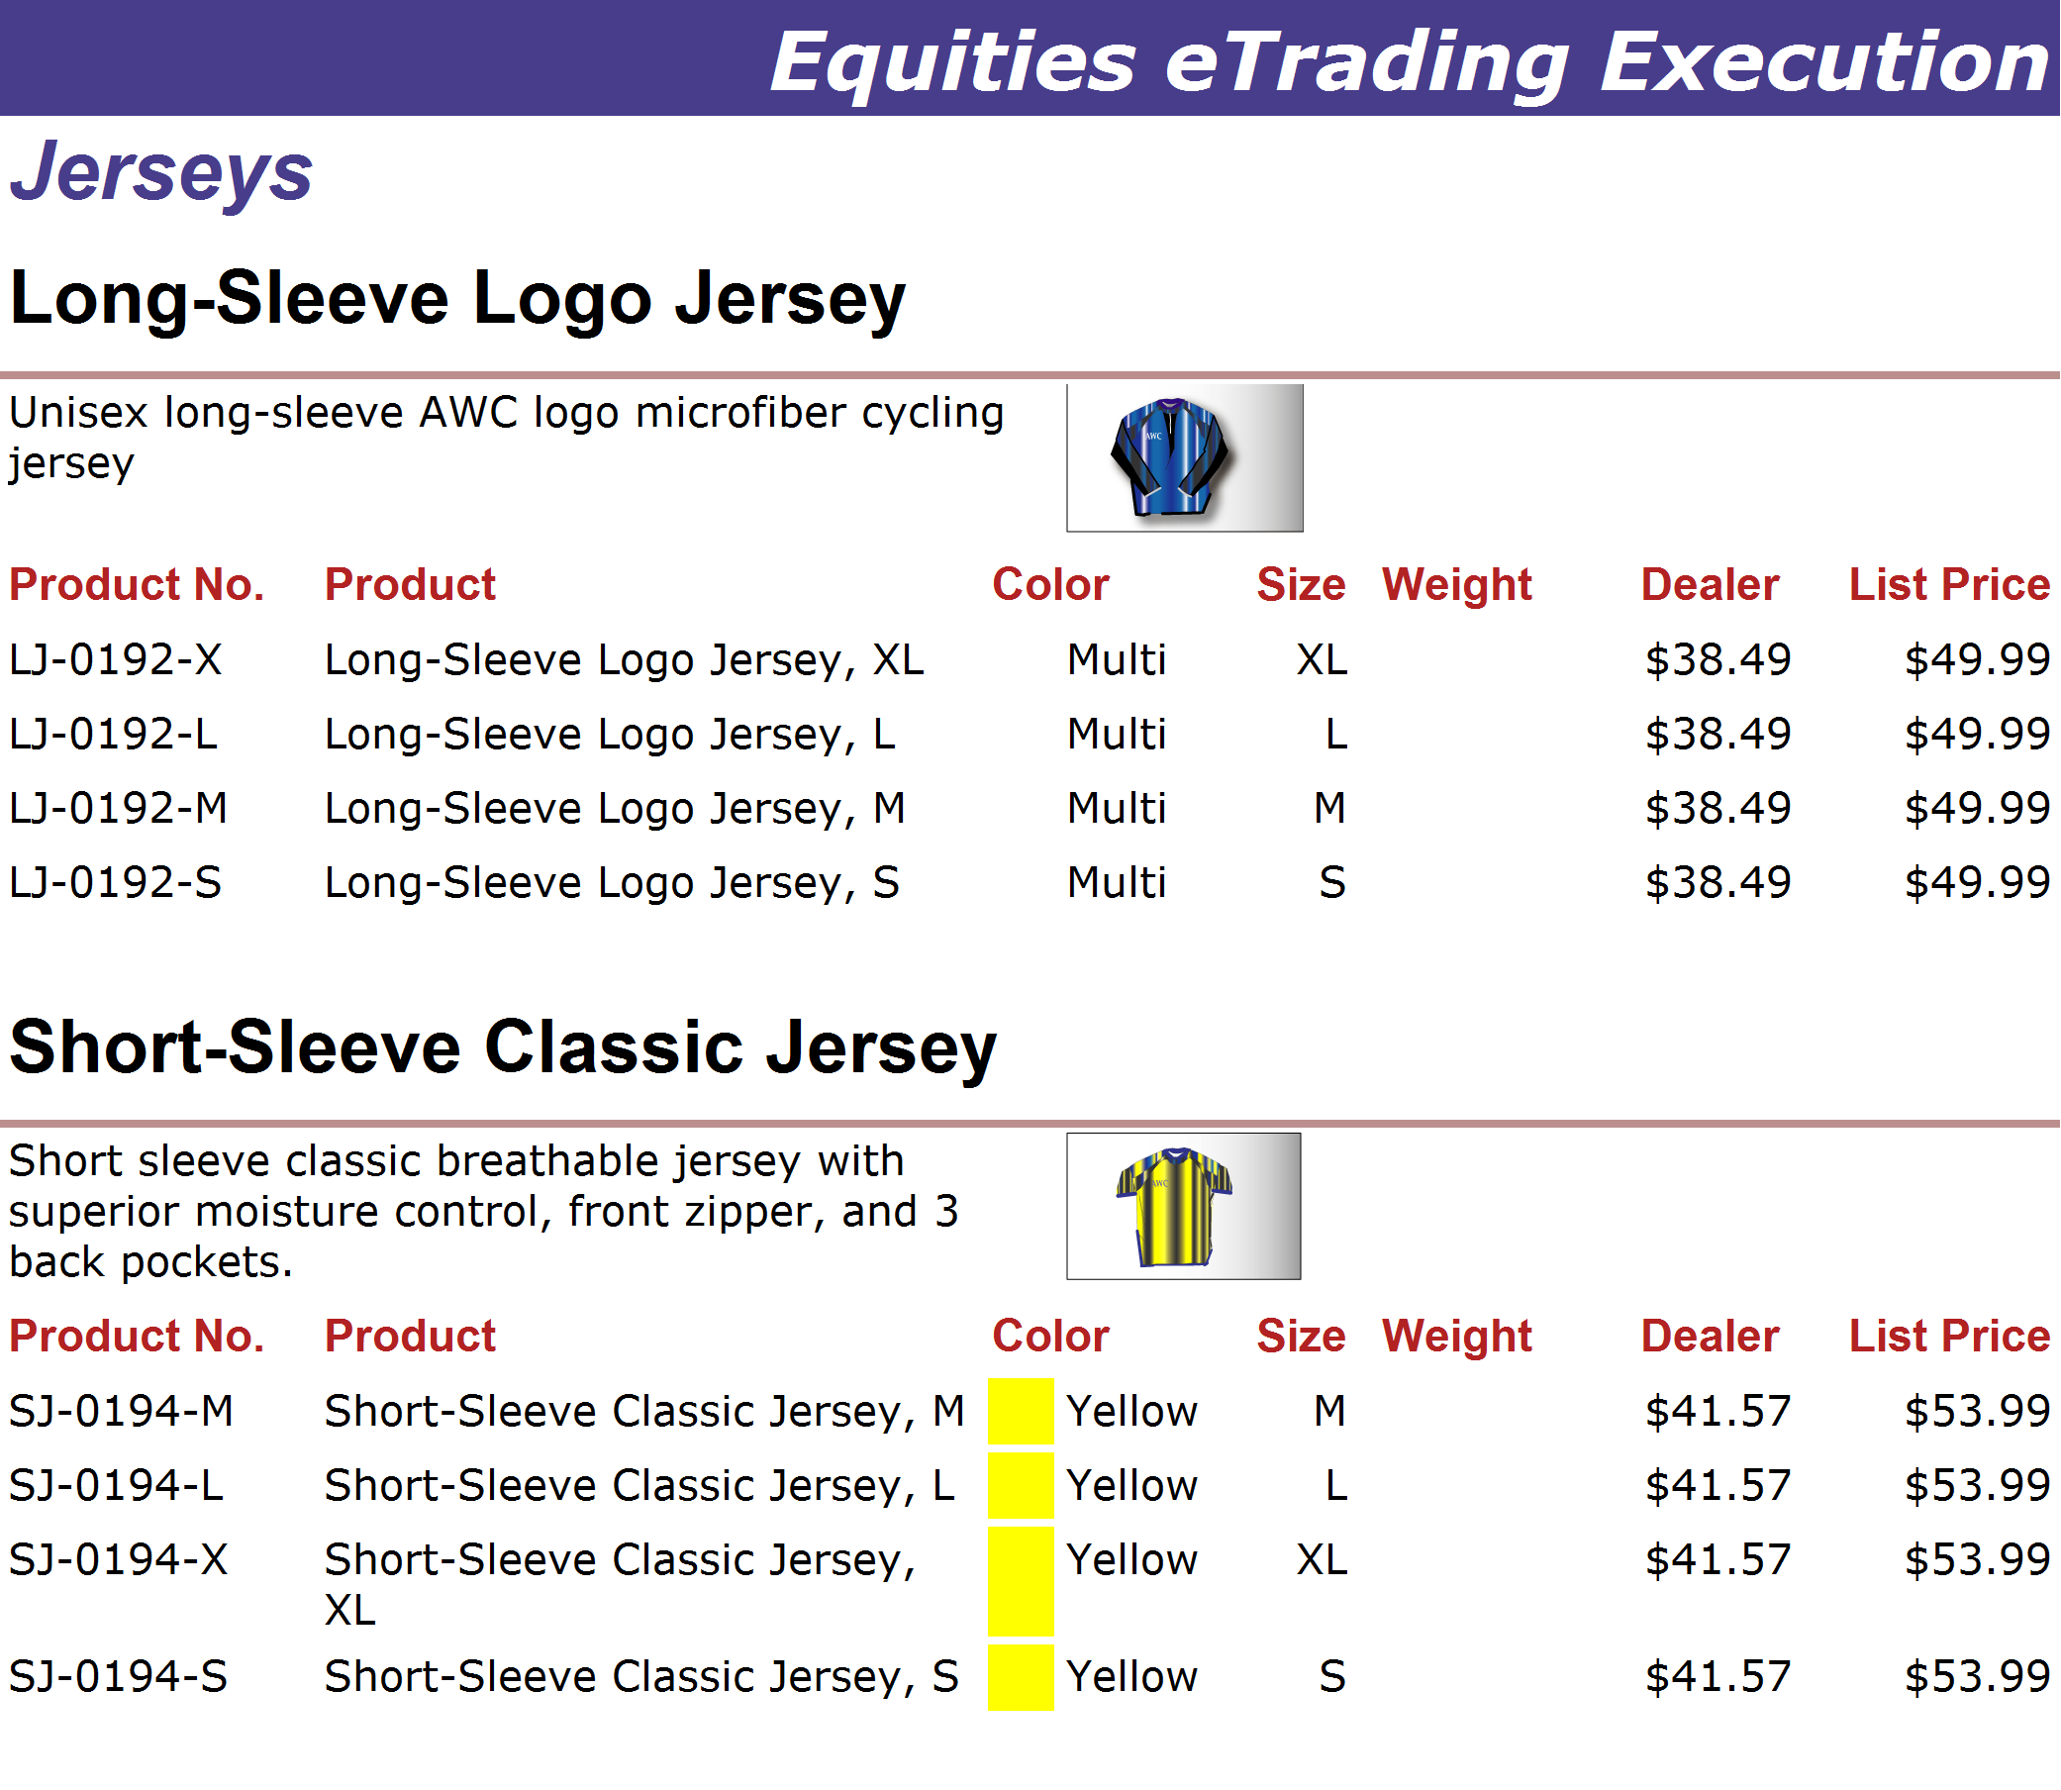
http://www.adventure-works.com
Page 16

Slide 17
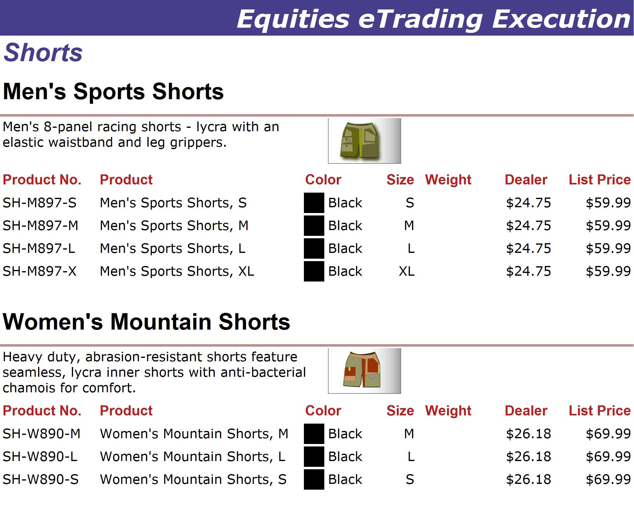
http://www.adventure-works.com
Page 17

Slide 18
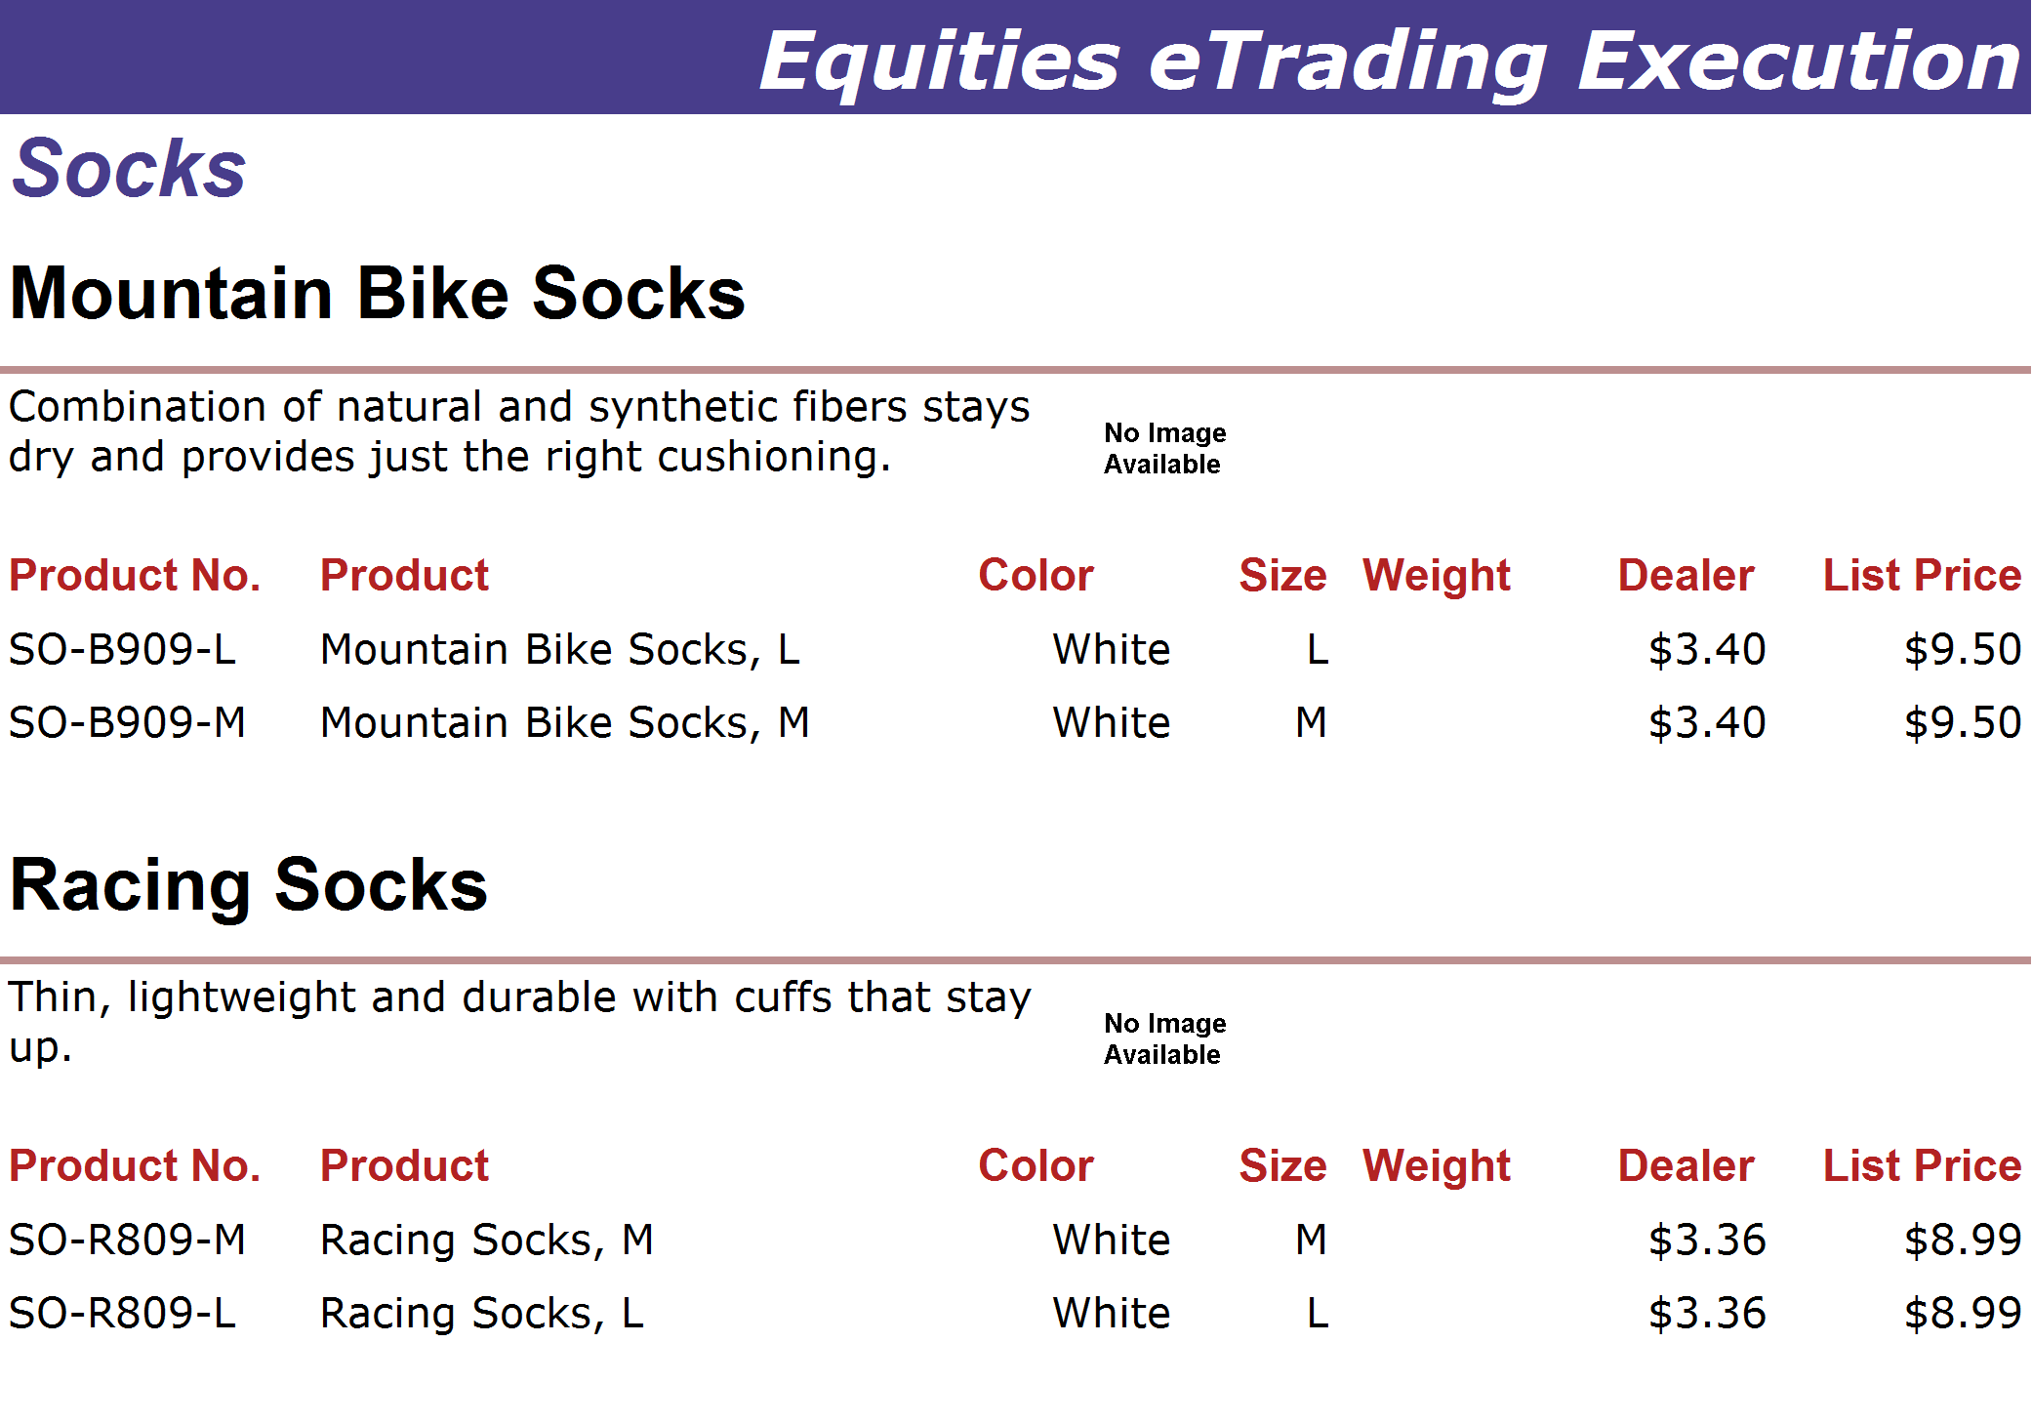
http://www.adventure-works.com
Page 18

Slide 19
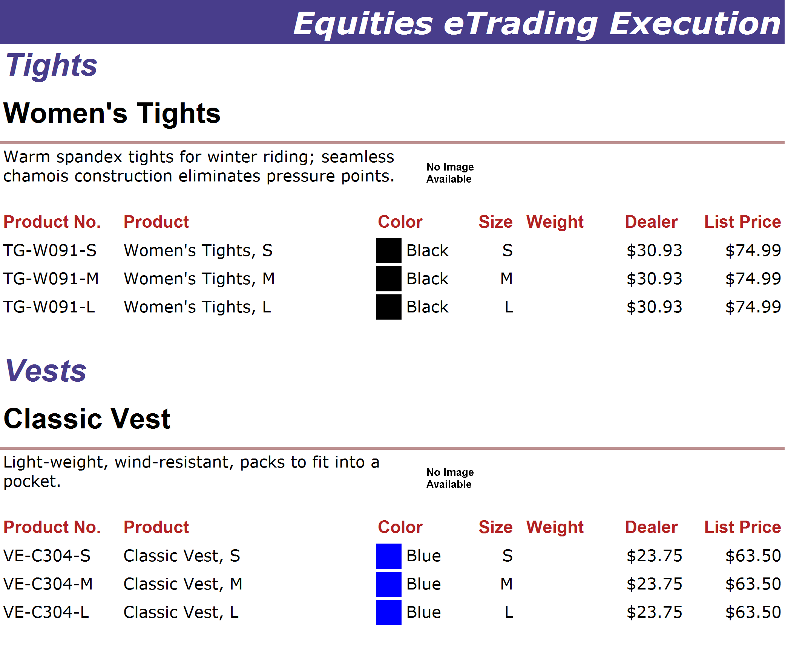
http://www.adventure-works.com
Page 19

Slide 20
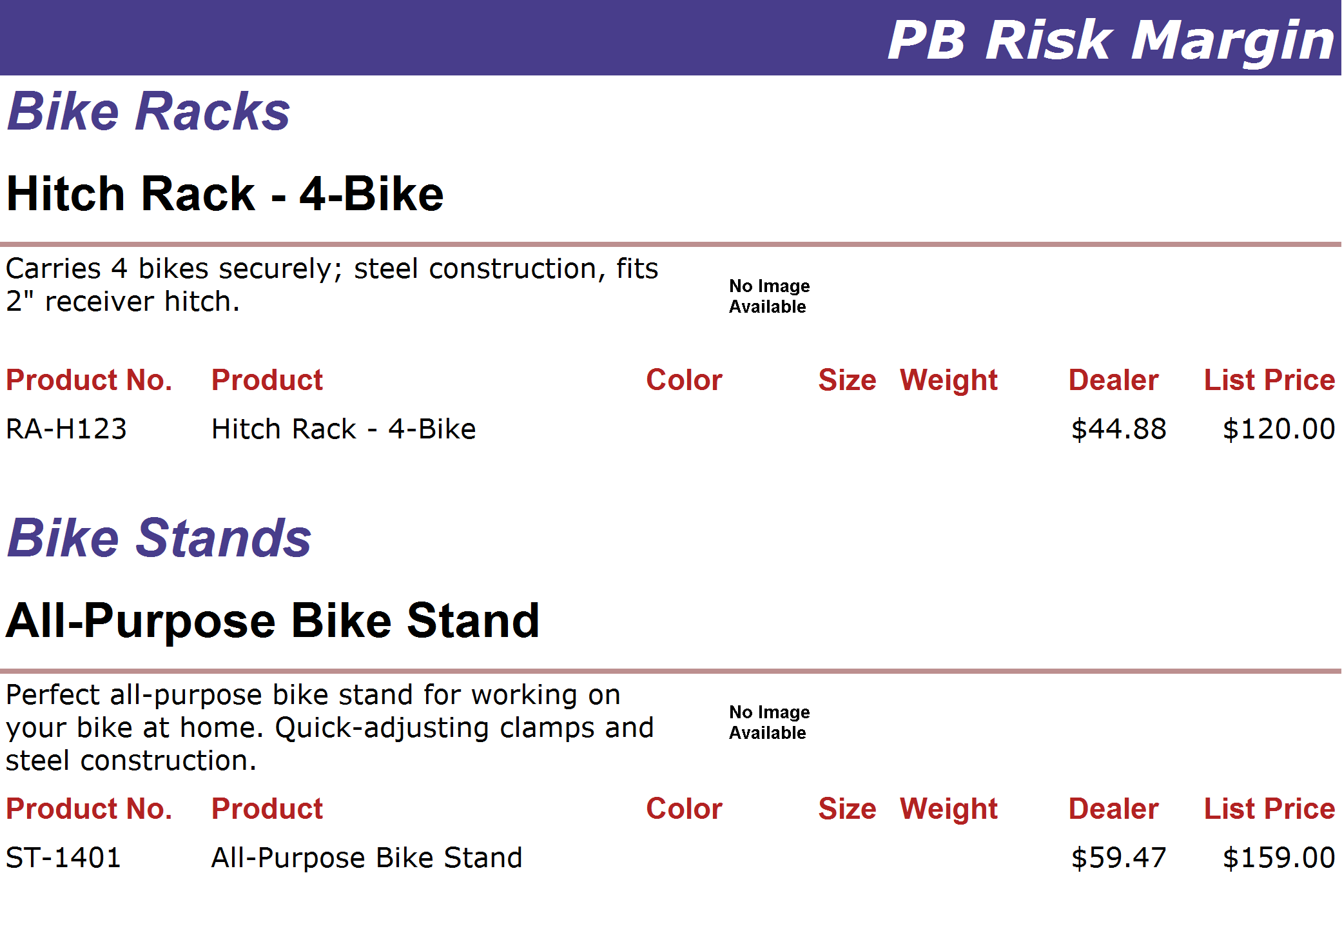
http://www.adventure-works.com
Page 20

Slide 21
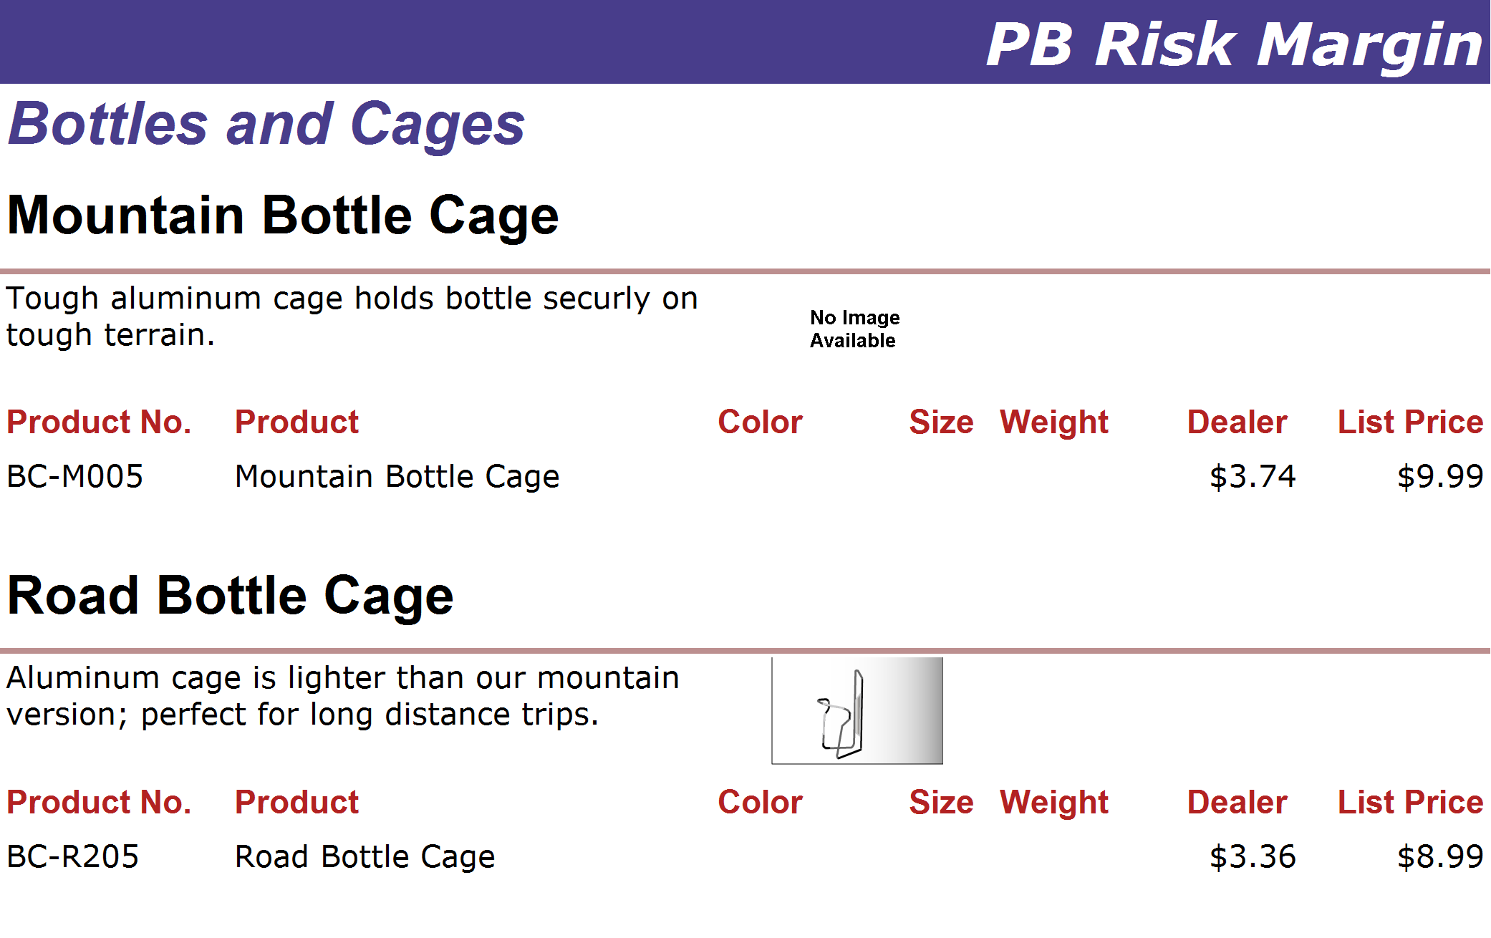
http://www.adventure-works.com
Page 21

Slide 22
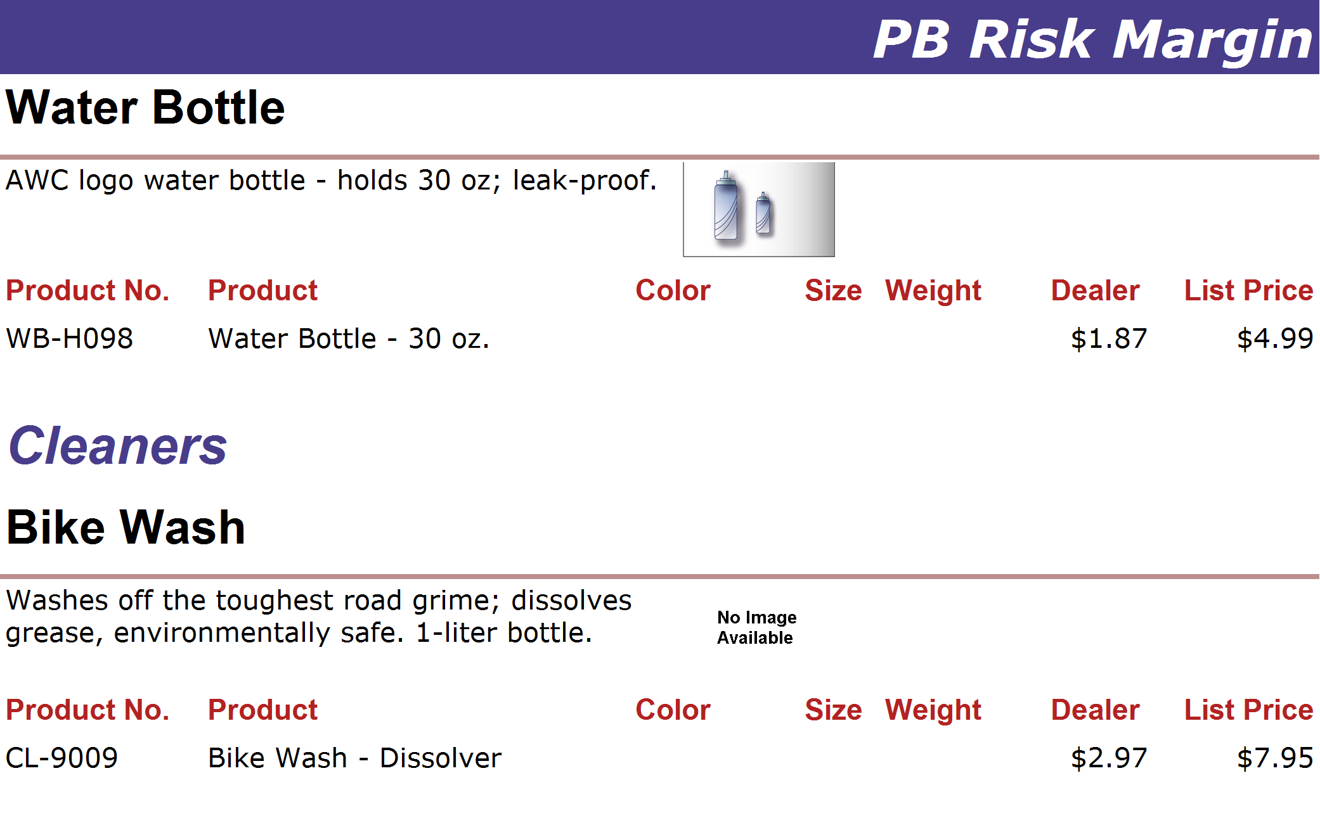
http://www.adventure-works.com
Page 22

Slide 23
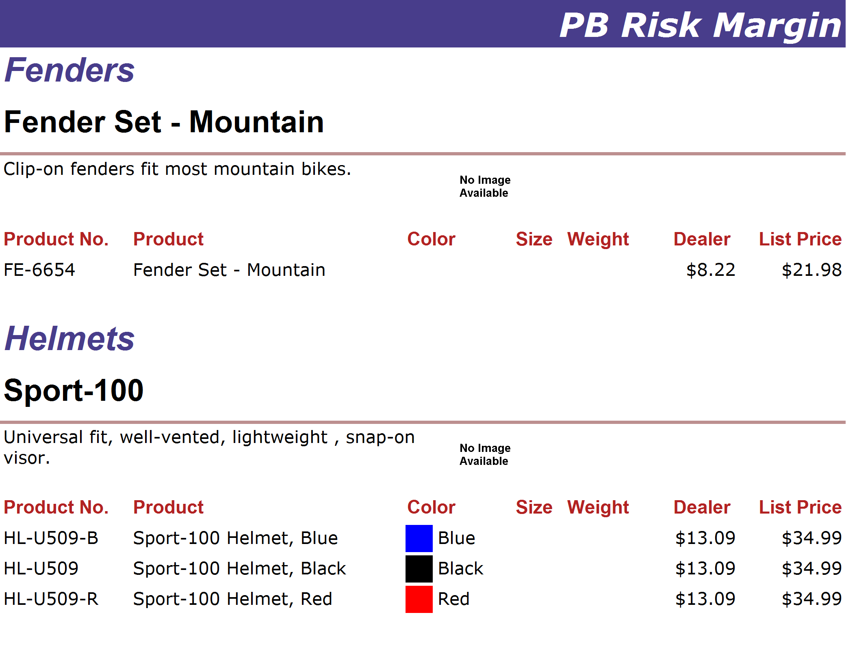
http://www.adventure-works.com
Page 23

Slide 24
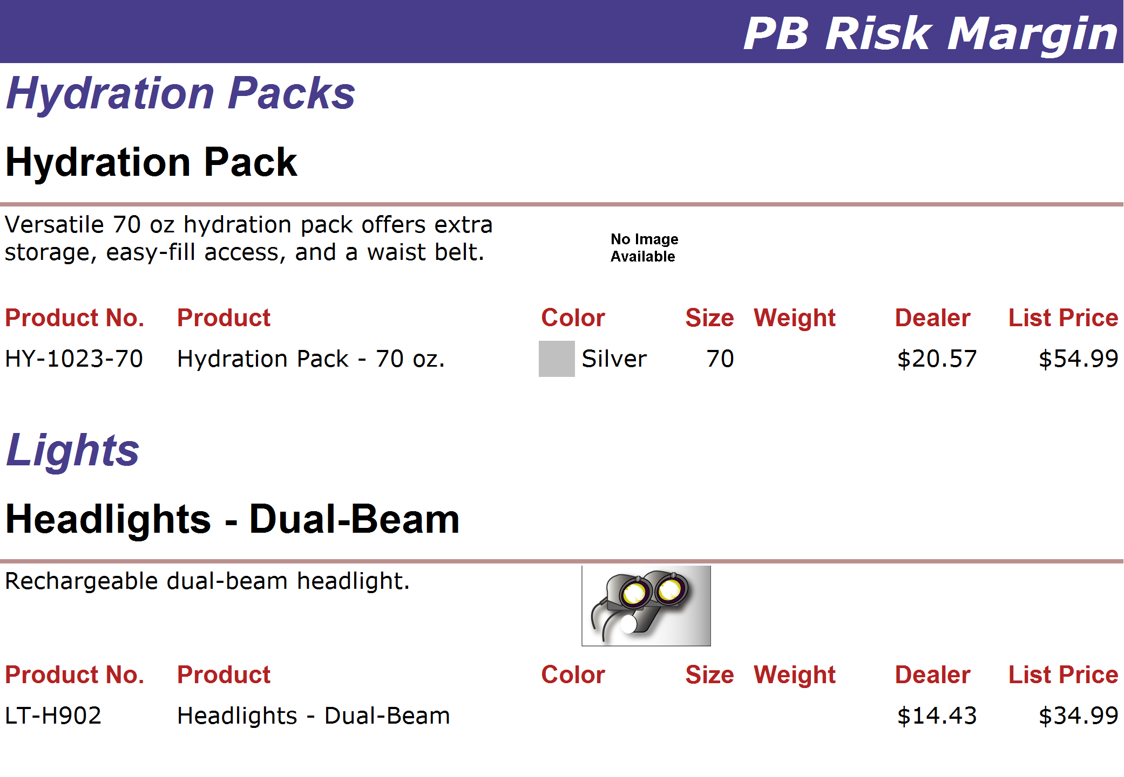
http://www.adventure-works.com
Page 24

Slide 25
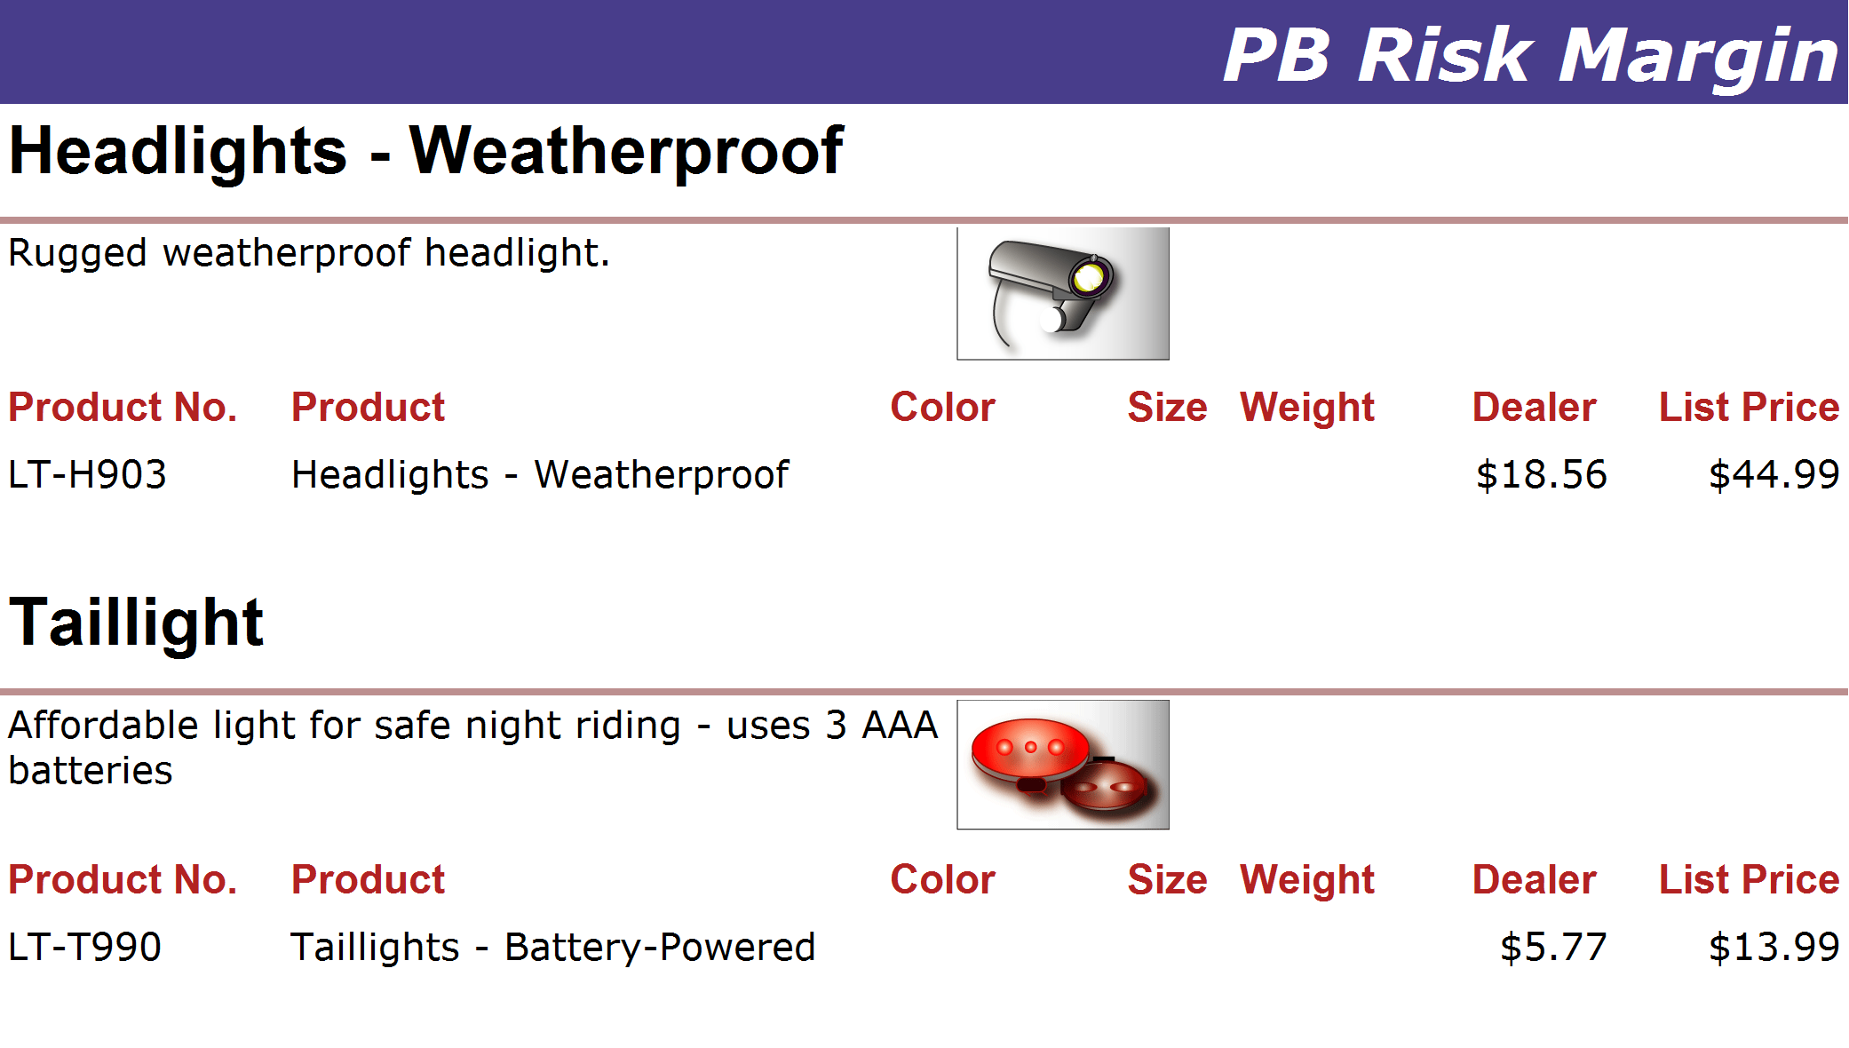
http://www.adventure-works.com
Page 25

Slide 26
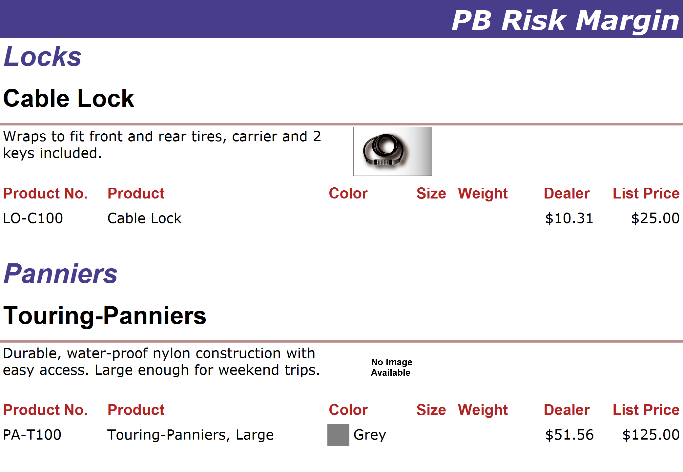
http://www.adventure-works.com
Page 26

Slide 27
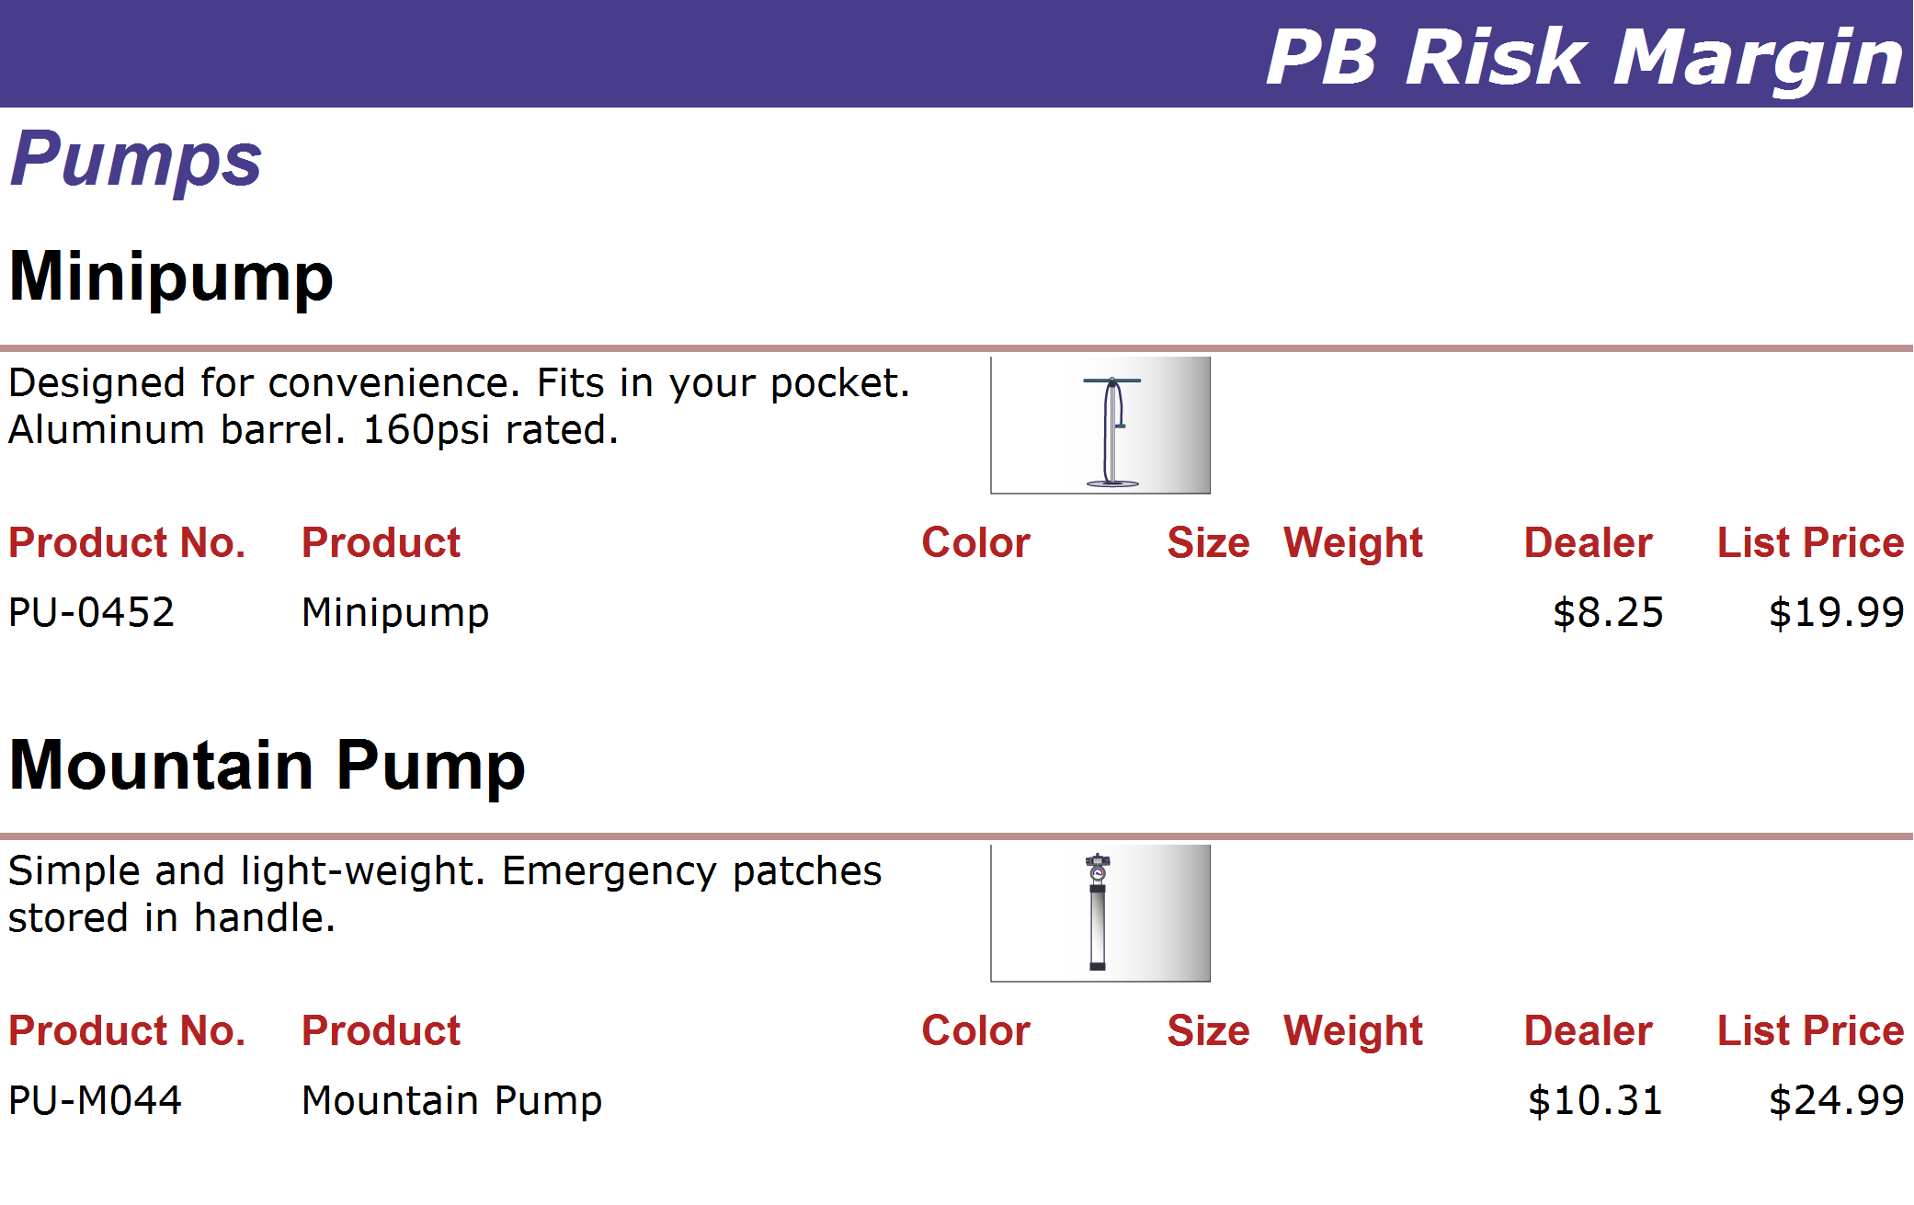
http://www.adventure-works.com
Page 27

Slide 28
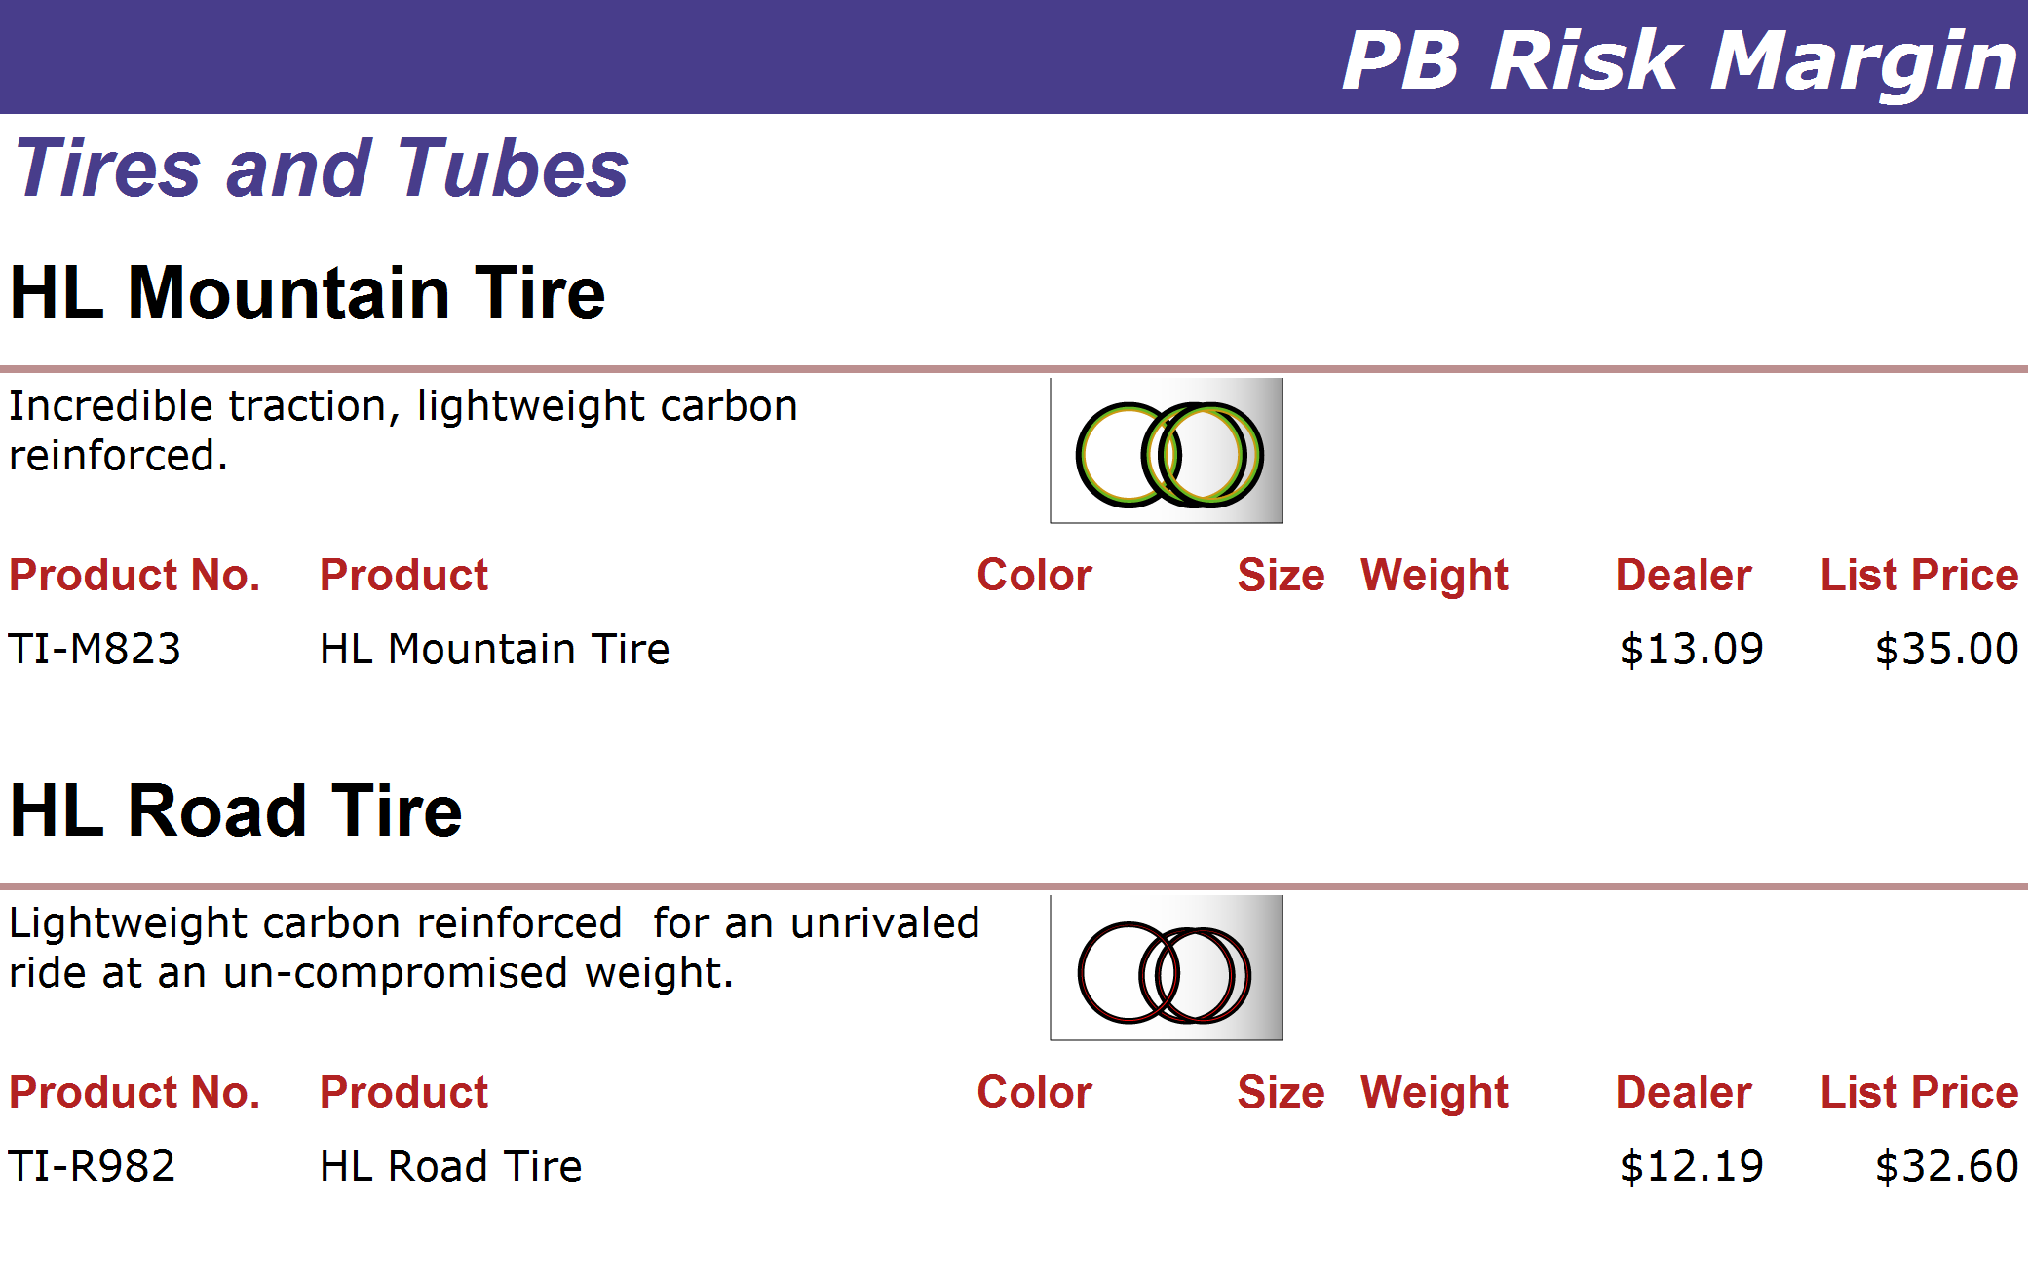
http://www.adventure-works.com
Page 28

Slide 29
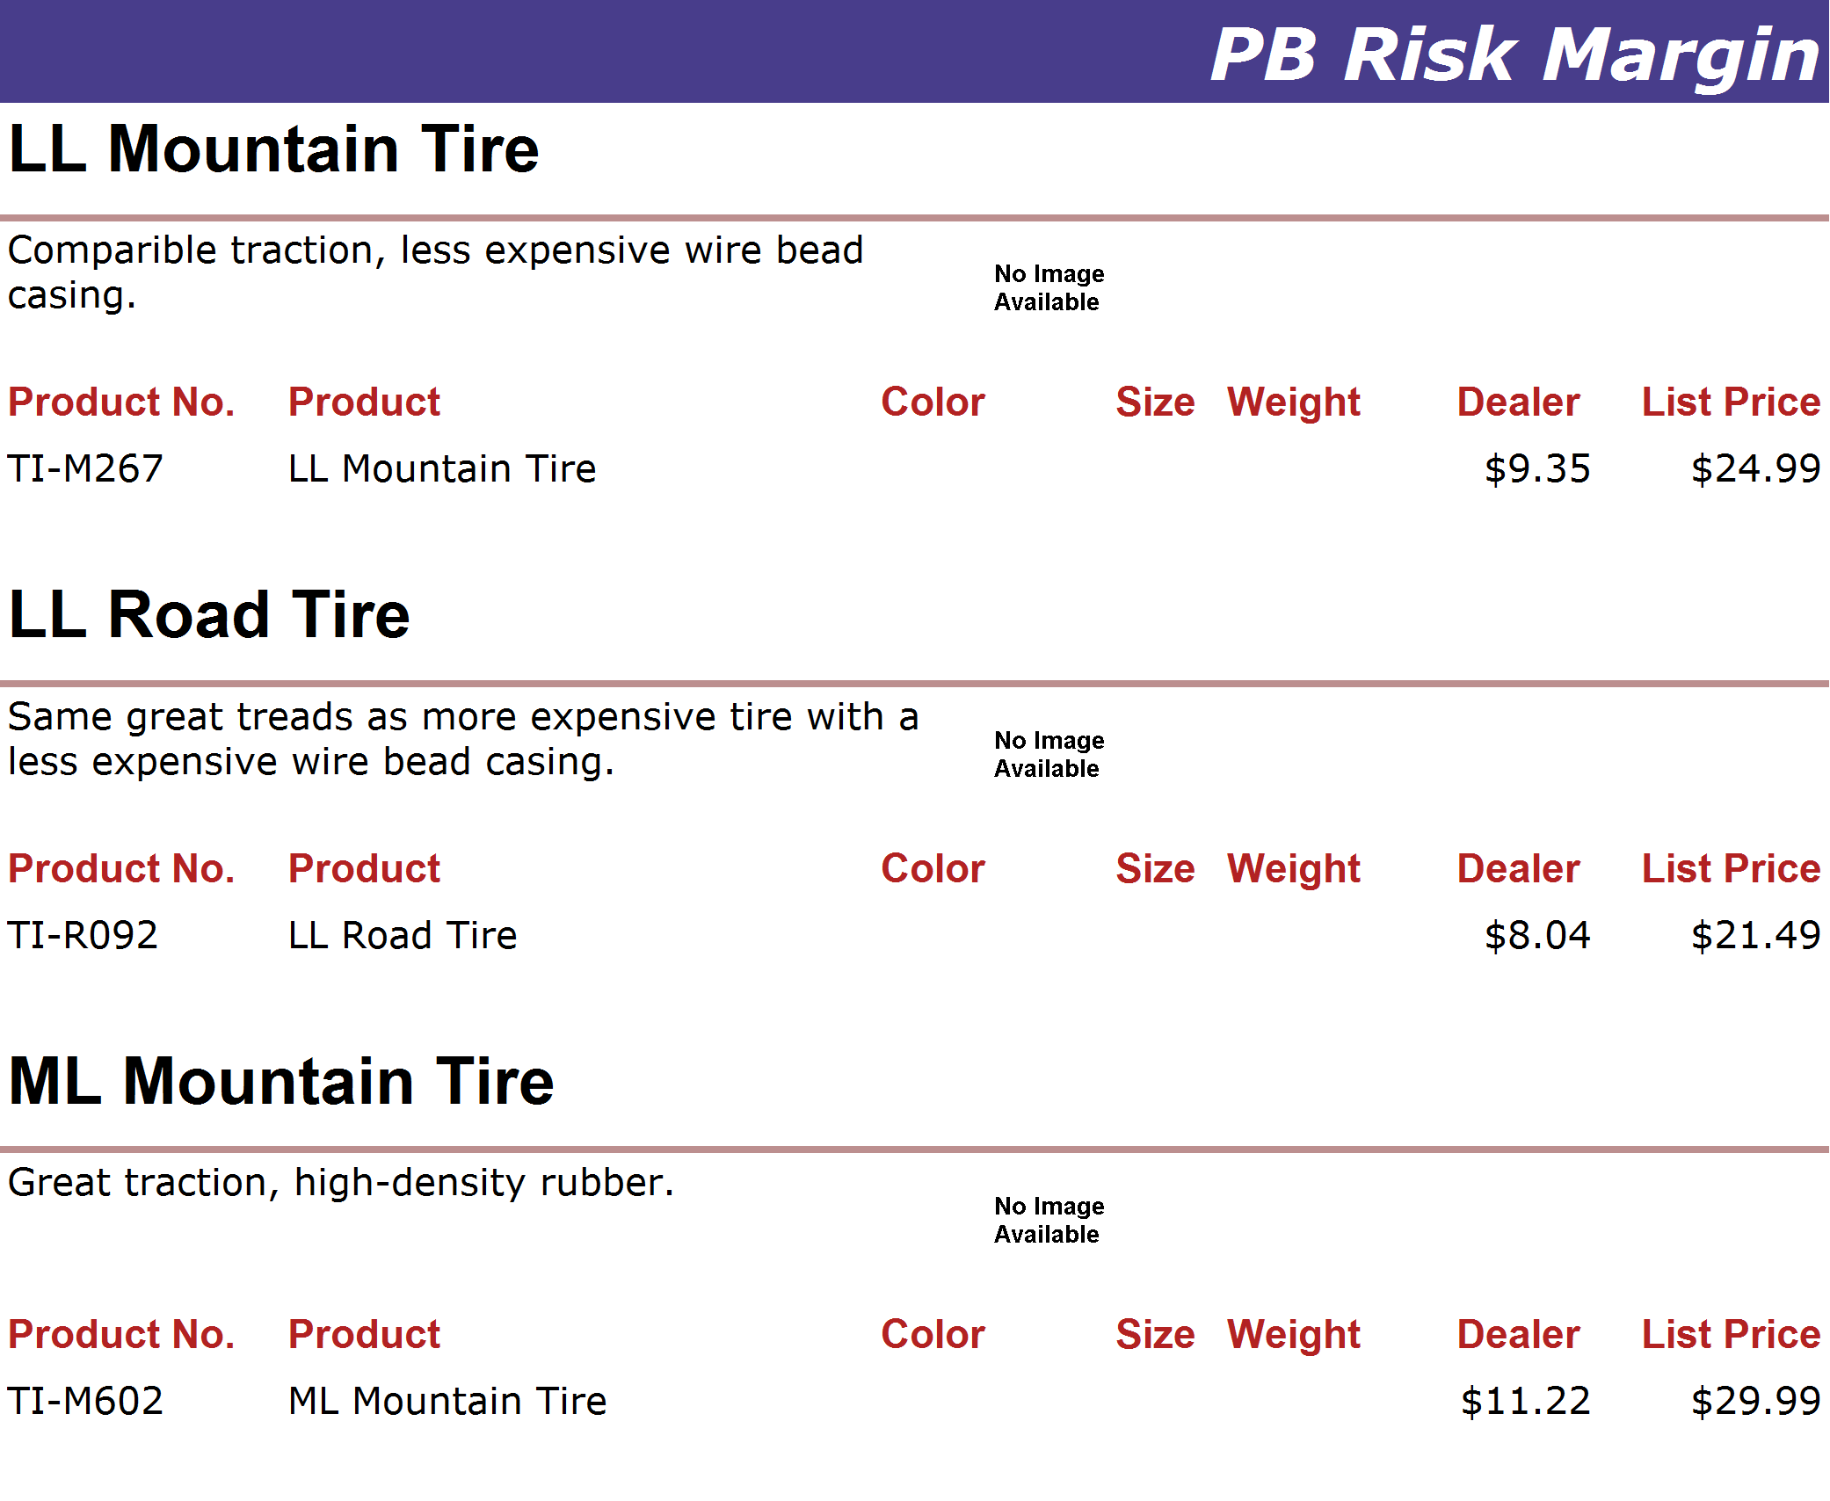
http://www.adventure-works.com
Page 29

Slide 30
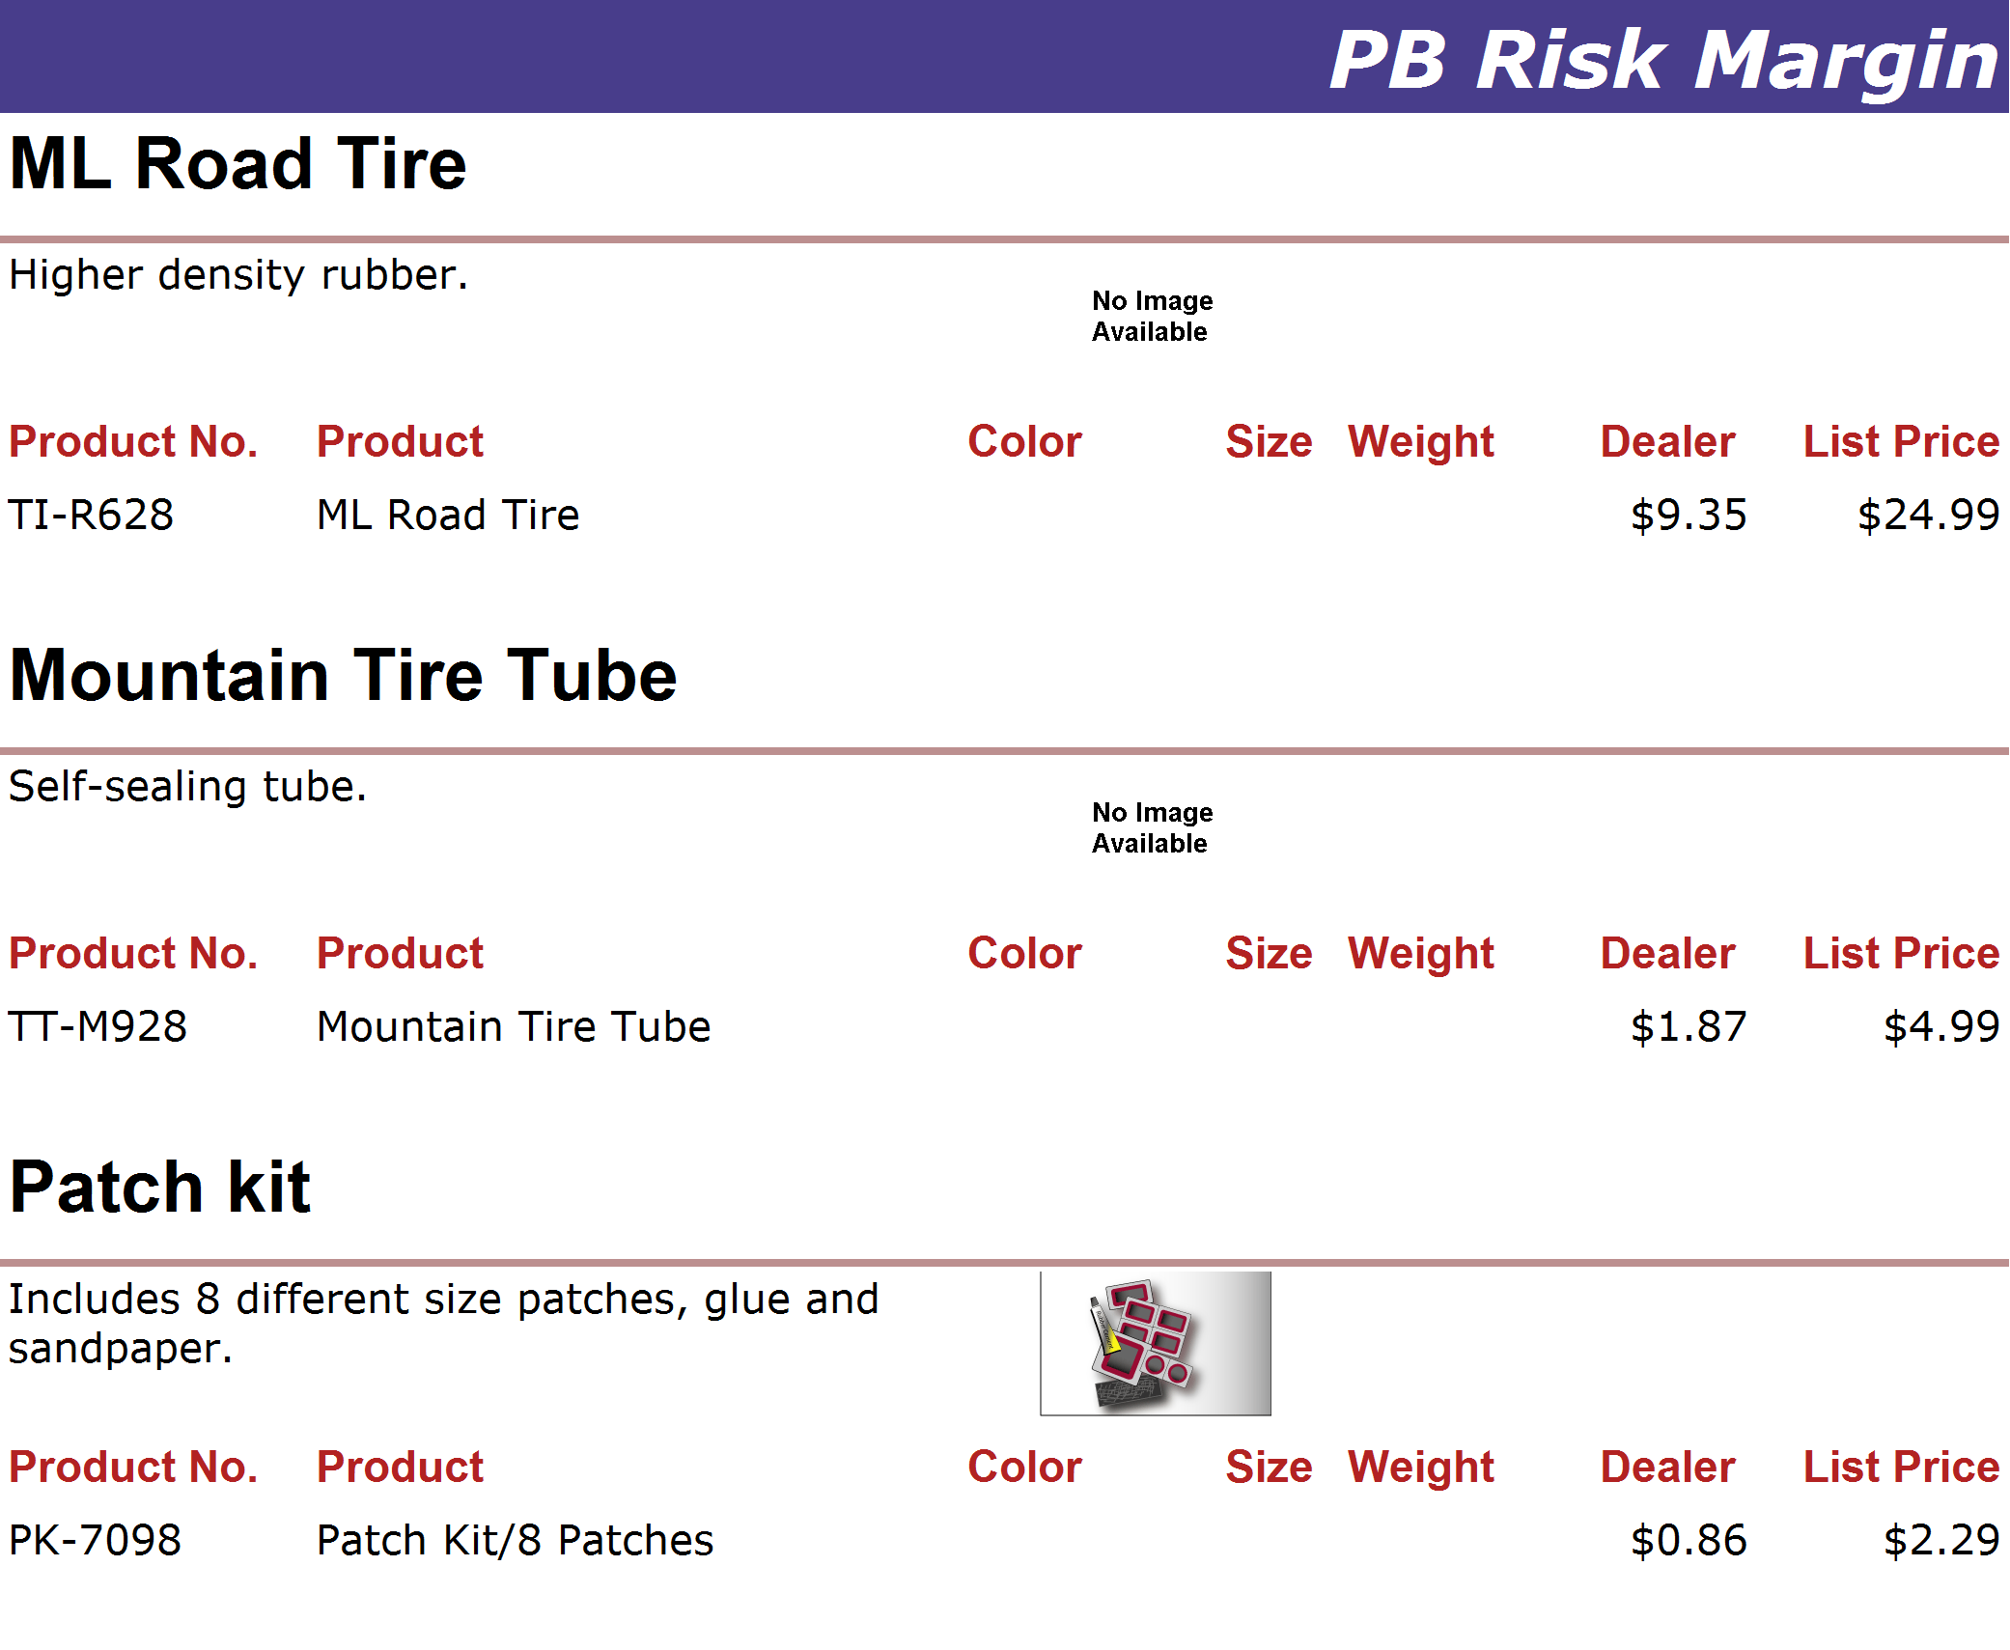
http://www.adventure-works.com
Page 30

Slide 31
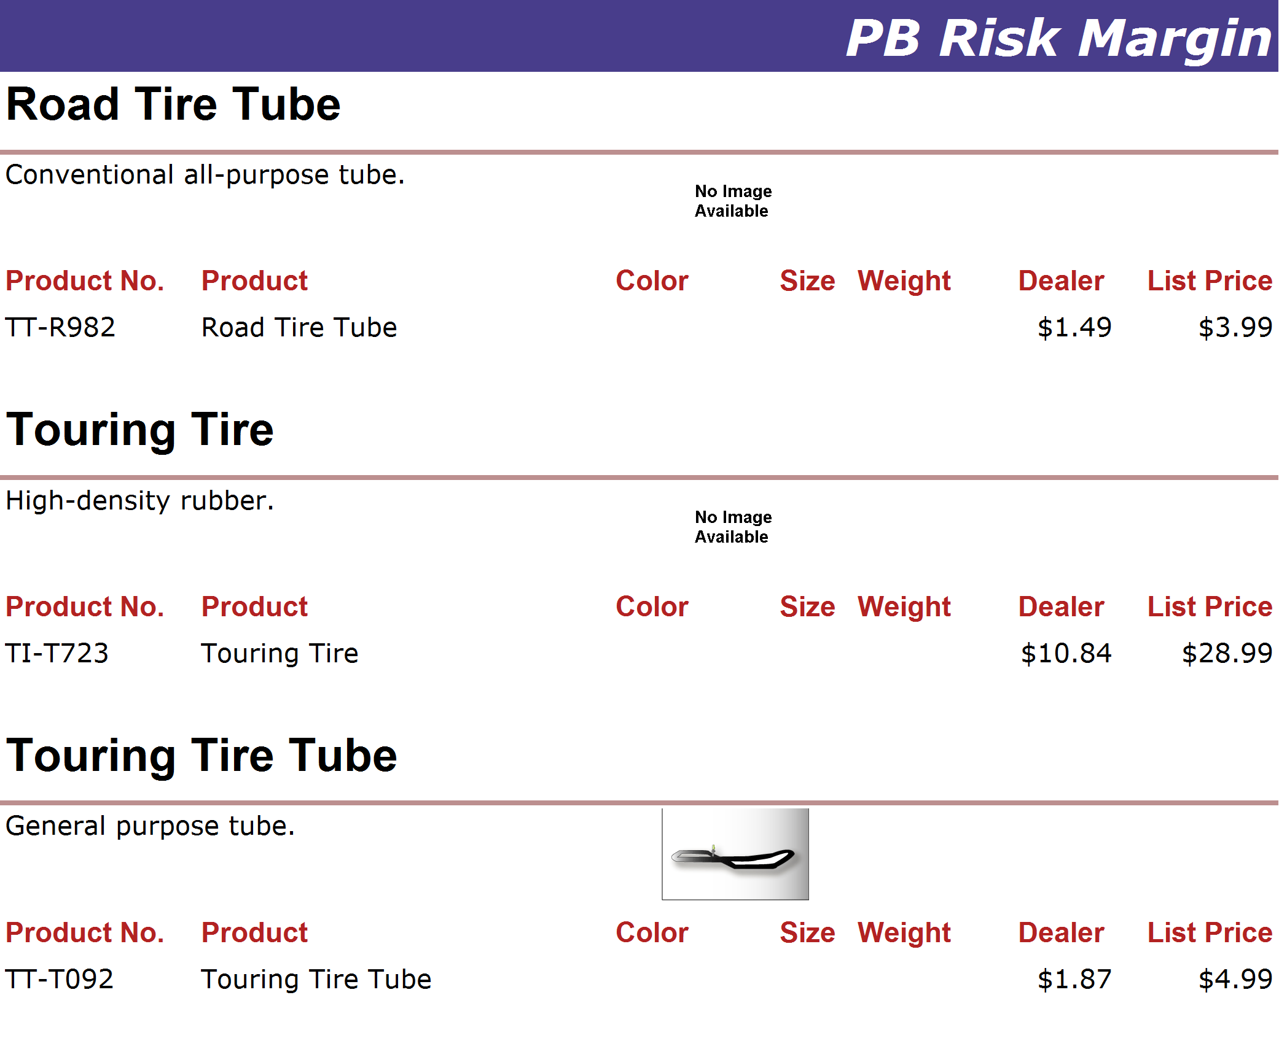
http://www.adventure-works.com
Page 31

Slide 32
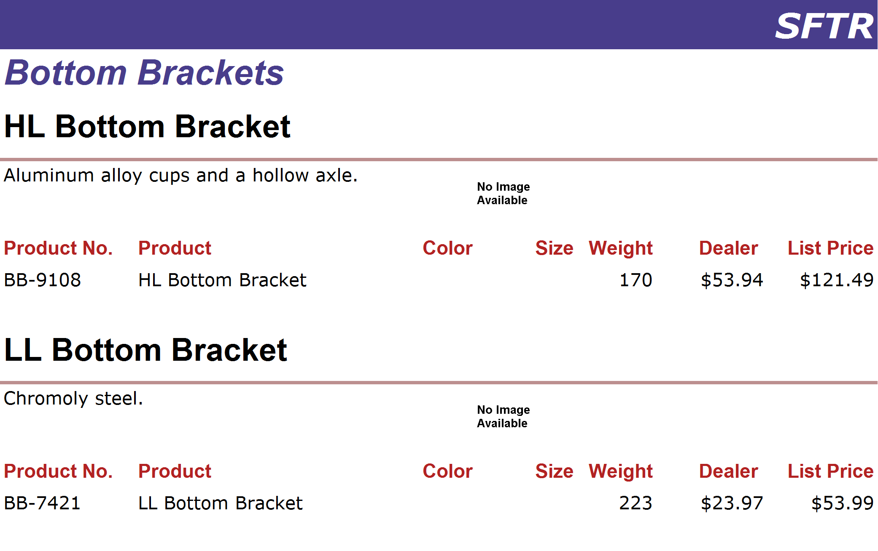
http://www.adventure-works.com
Page 32

Slide 33
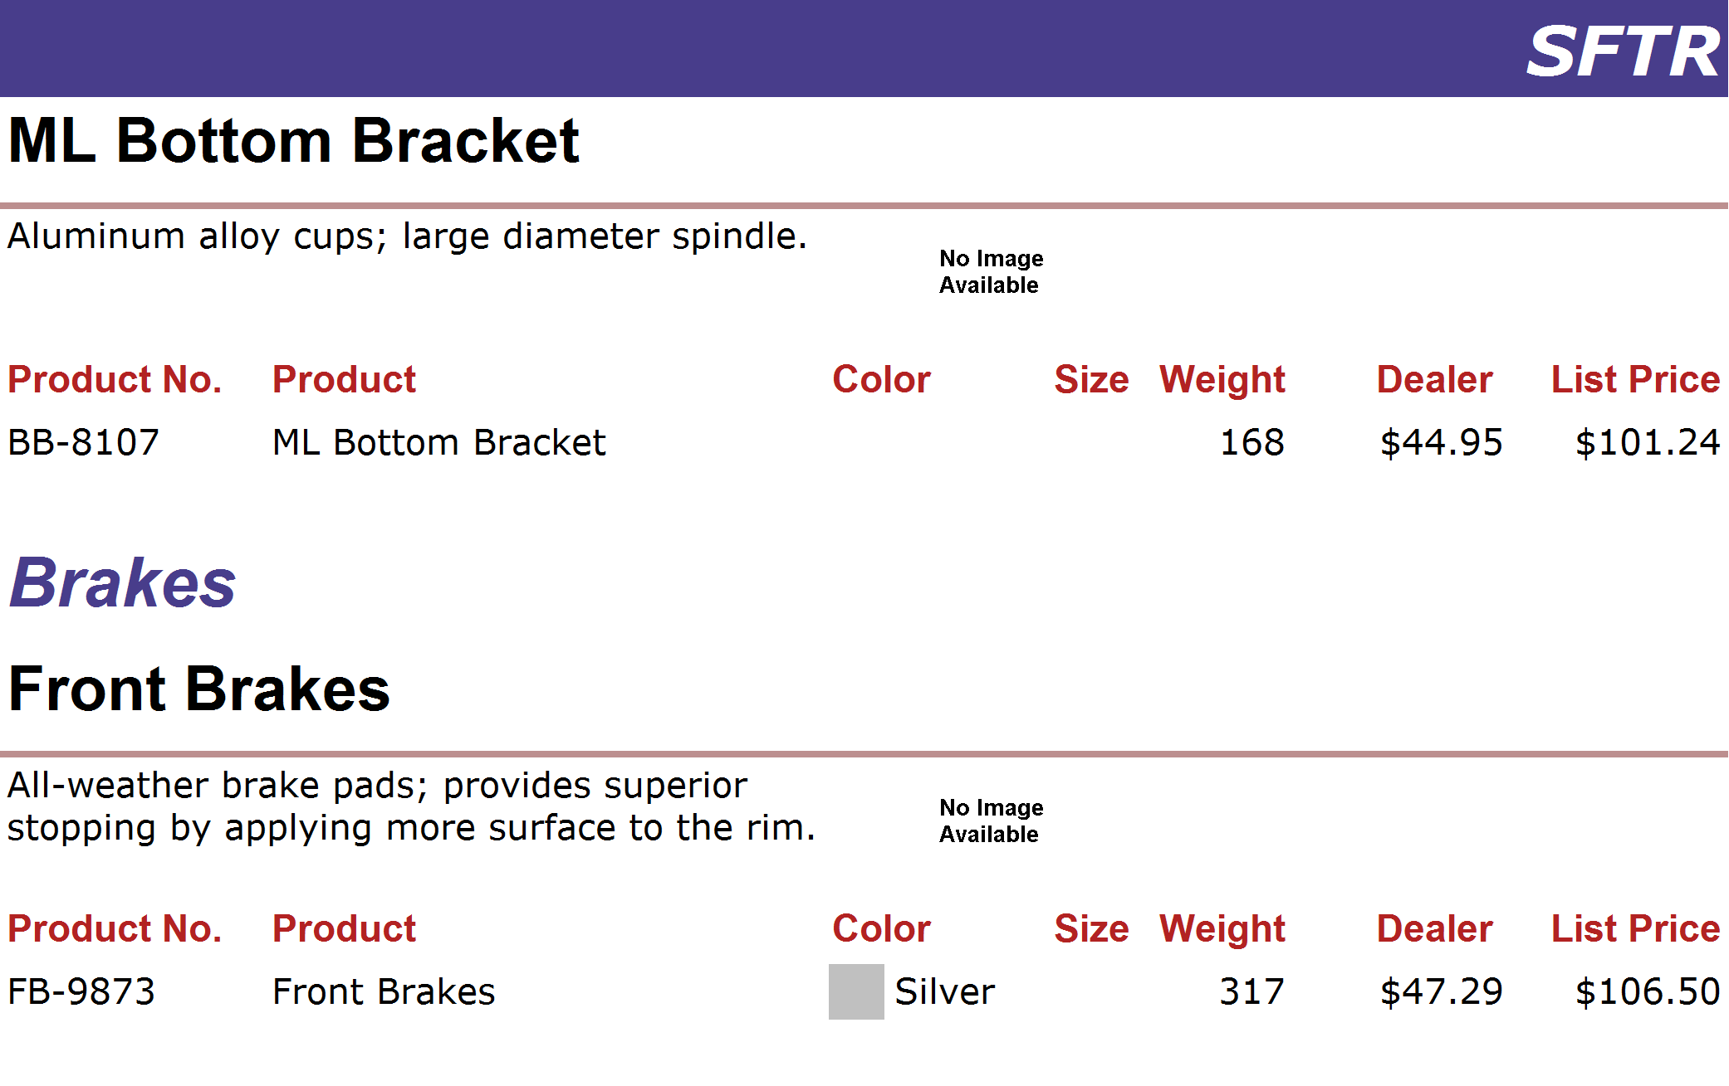
http://www.adventure-works.com
Page 33

Slide 34
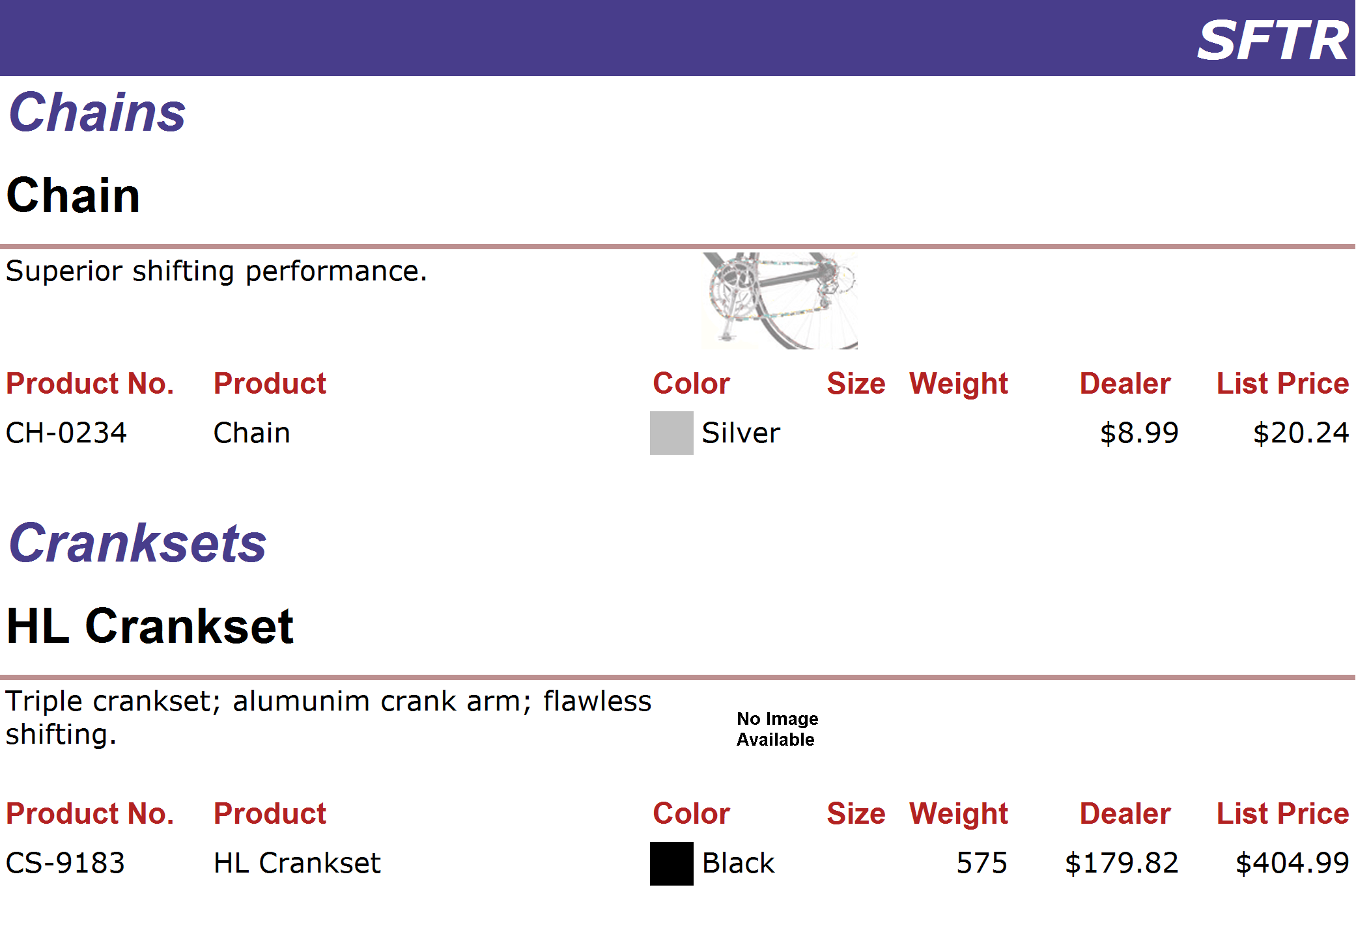
http://www.adventure-works.com
Page 34

Slide 35
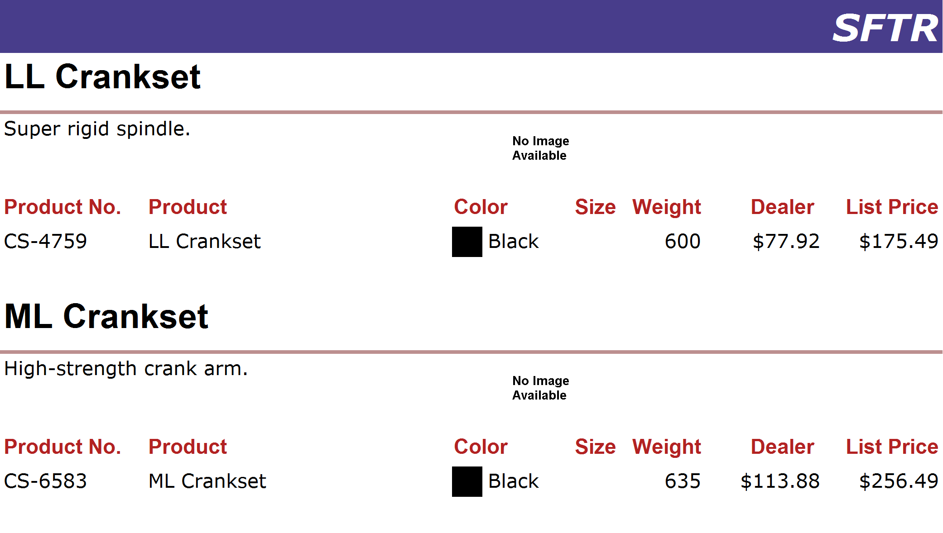
http://www.adventure-works.com
Page 35

Slide 36
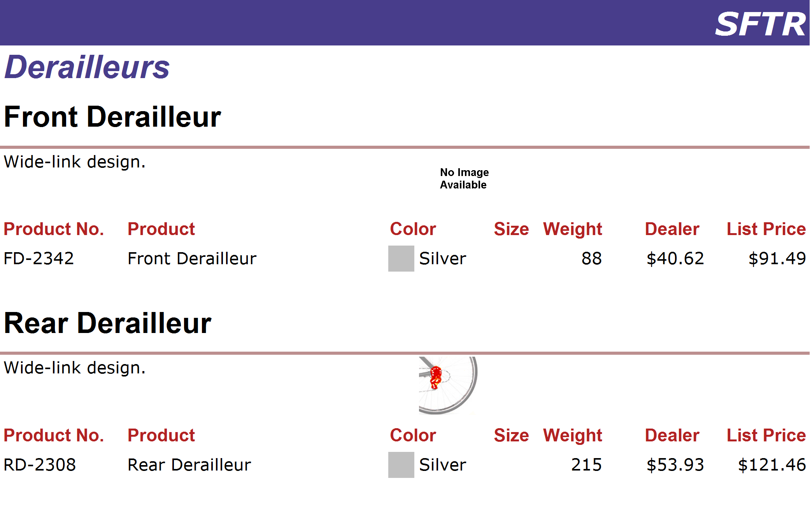
http://www.adventure-works.com
Page 36

Slide 37
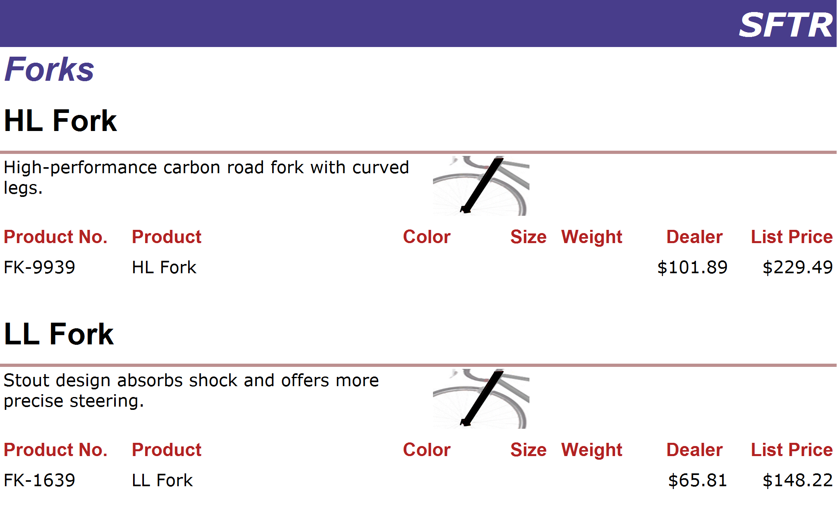
http://www.adventure-works.com
Page 37

Slide 38
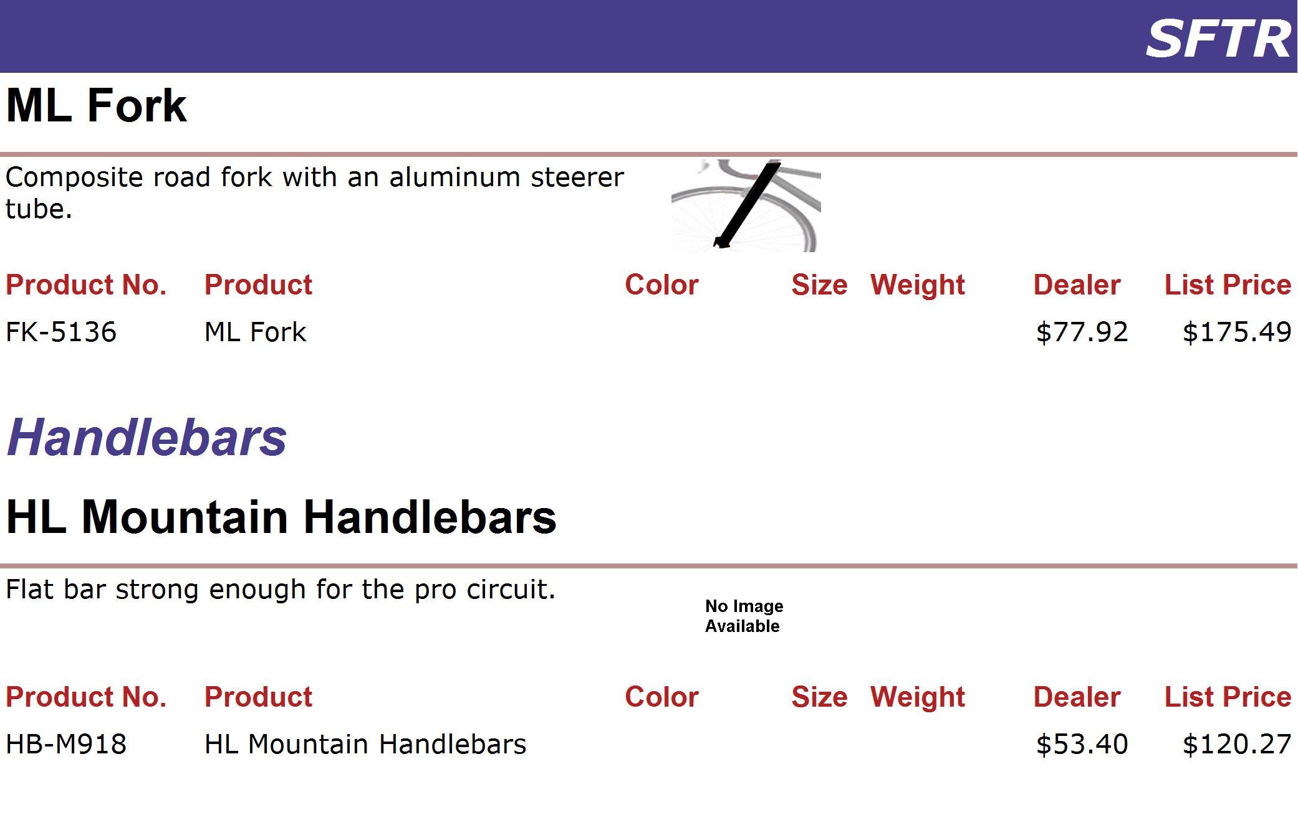
http://www.adventure-works.com
Page 38

Slide 39
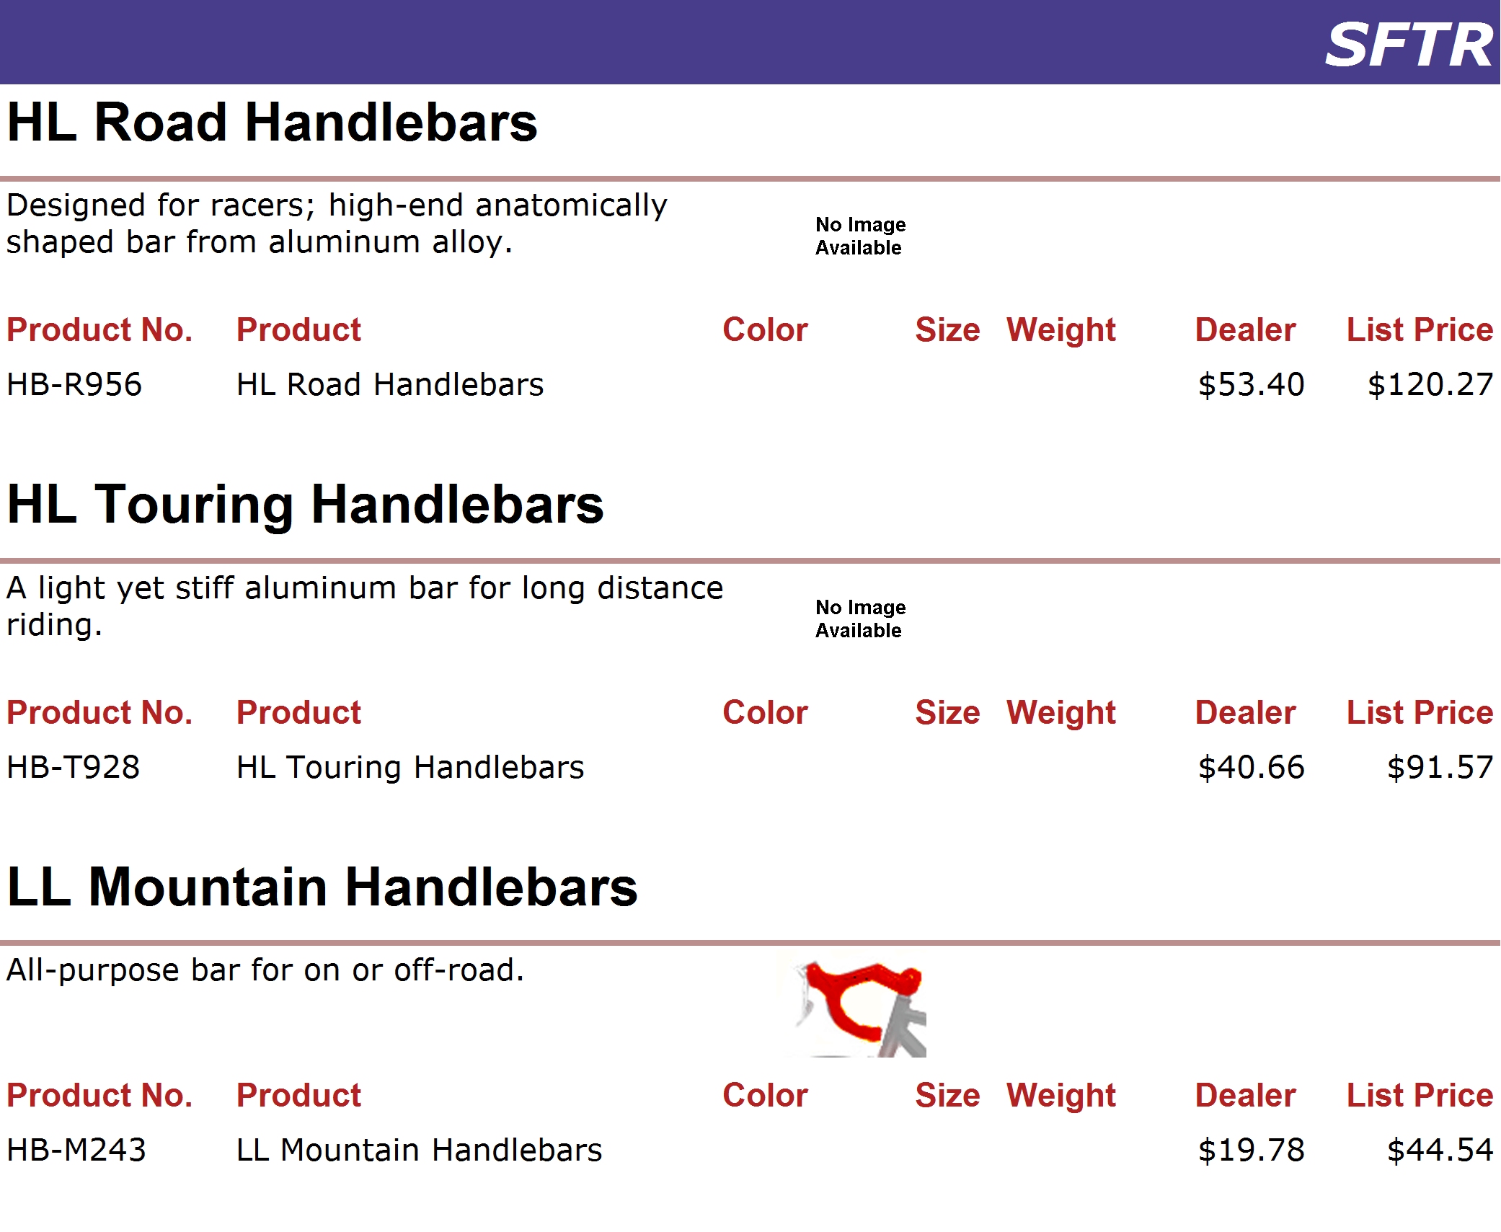
http://www.adventure-works.com
Page 39

Slide 40
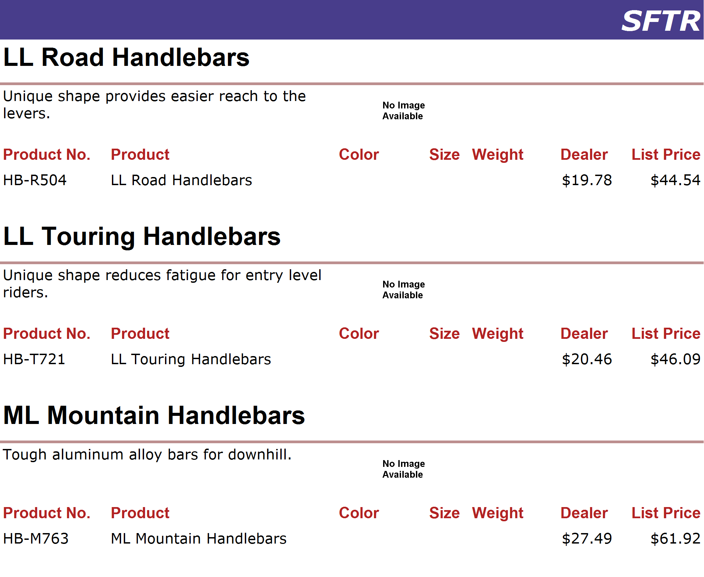
http://www.adventure-works.com
Page 40

Slide 41
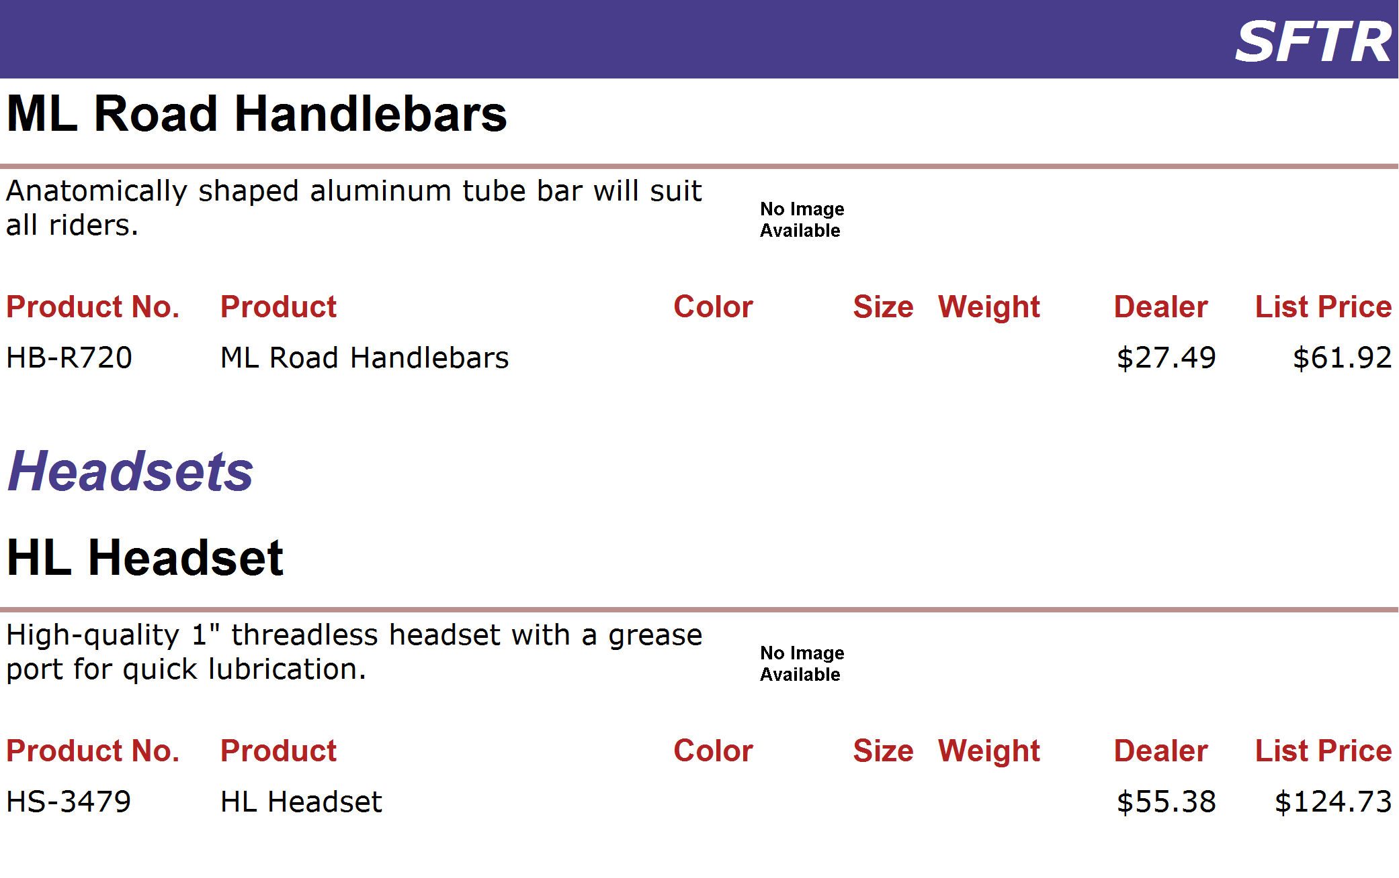
http://www.adventure-works.com
Page 41

Slide 42
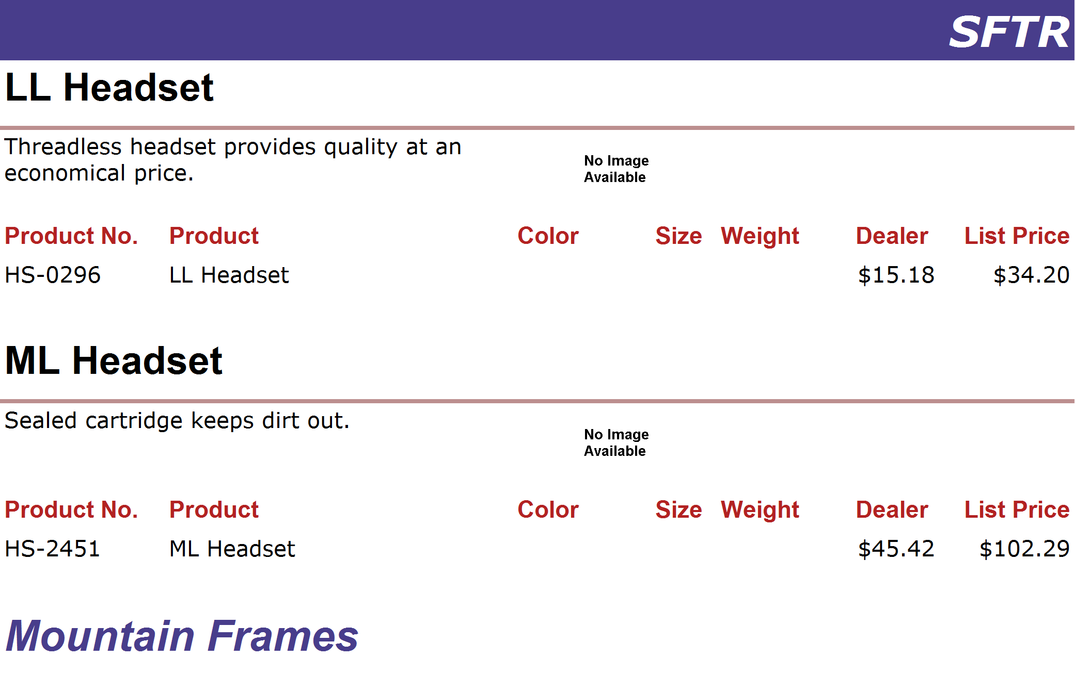
http://www.adventure-works.com
Page 42

Slide 43
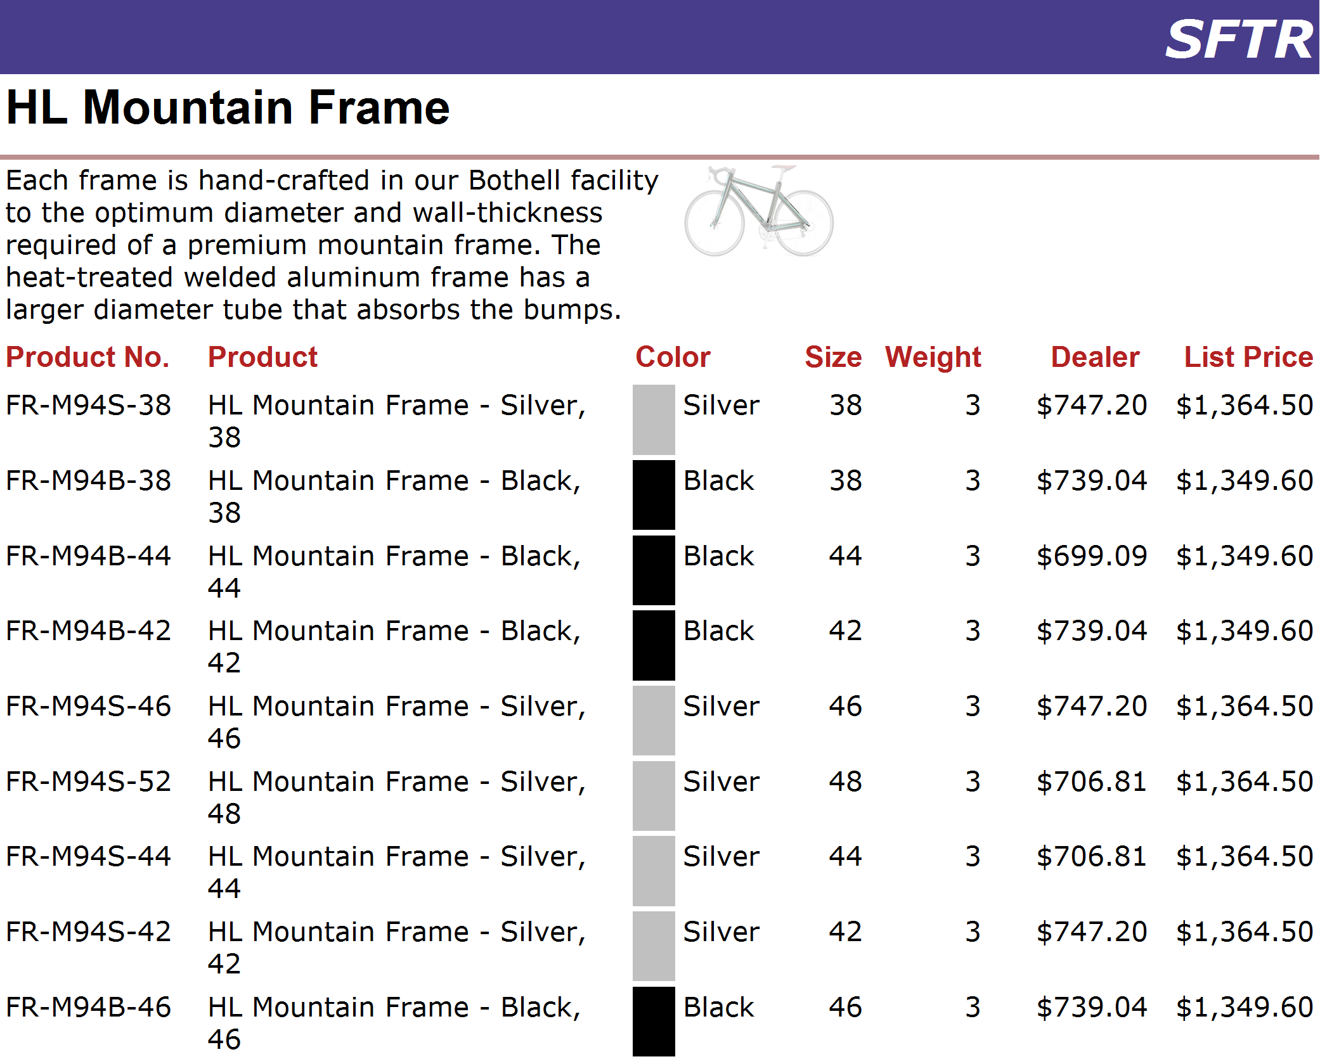
http://www.adventure-works.com
Page 43

Slide 44
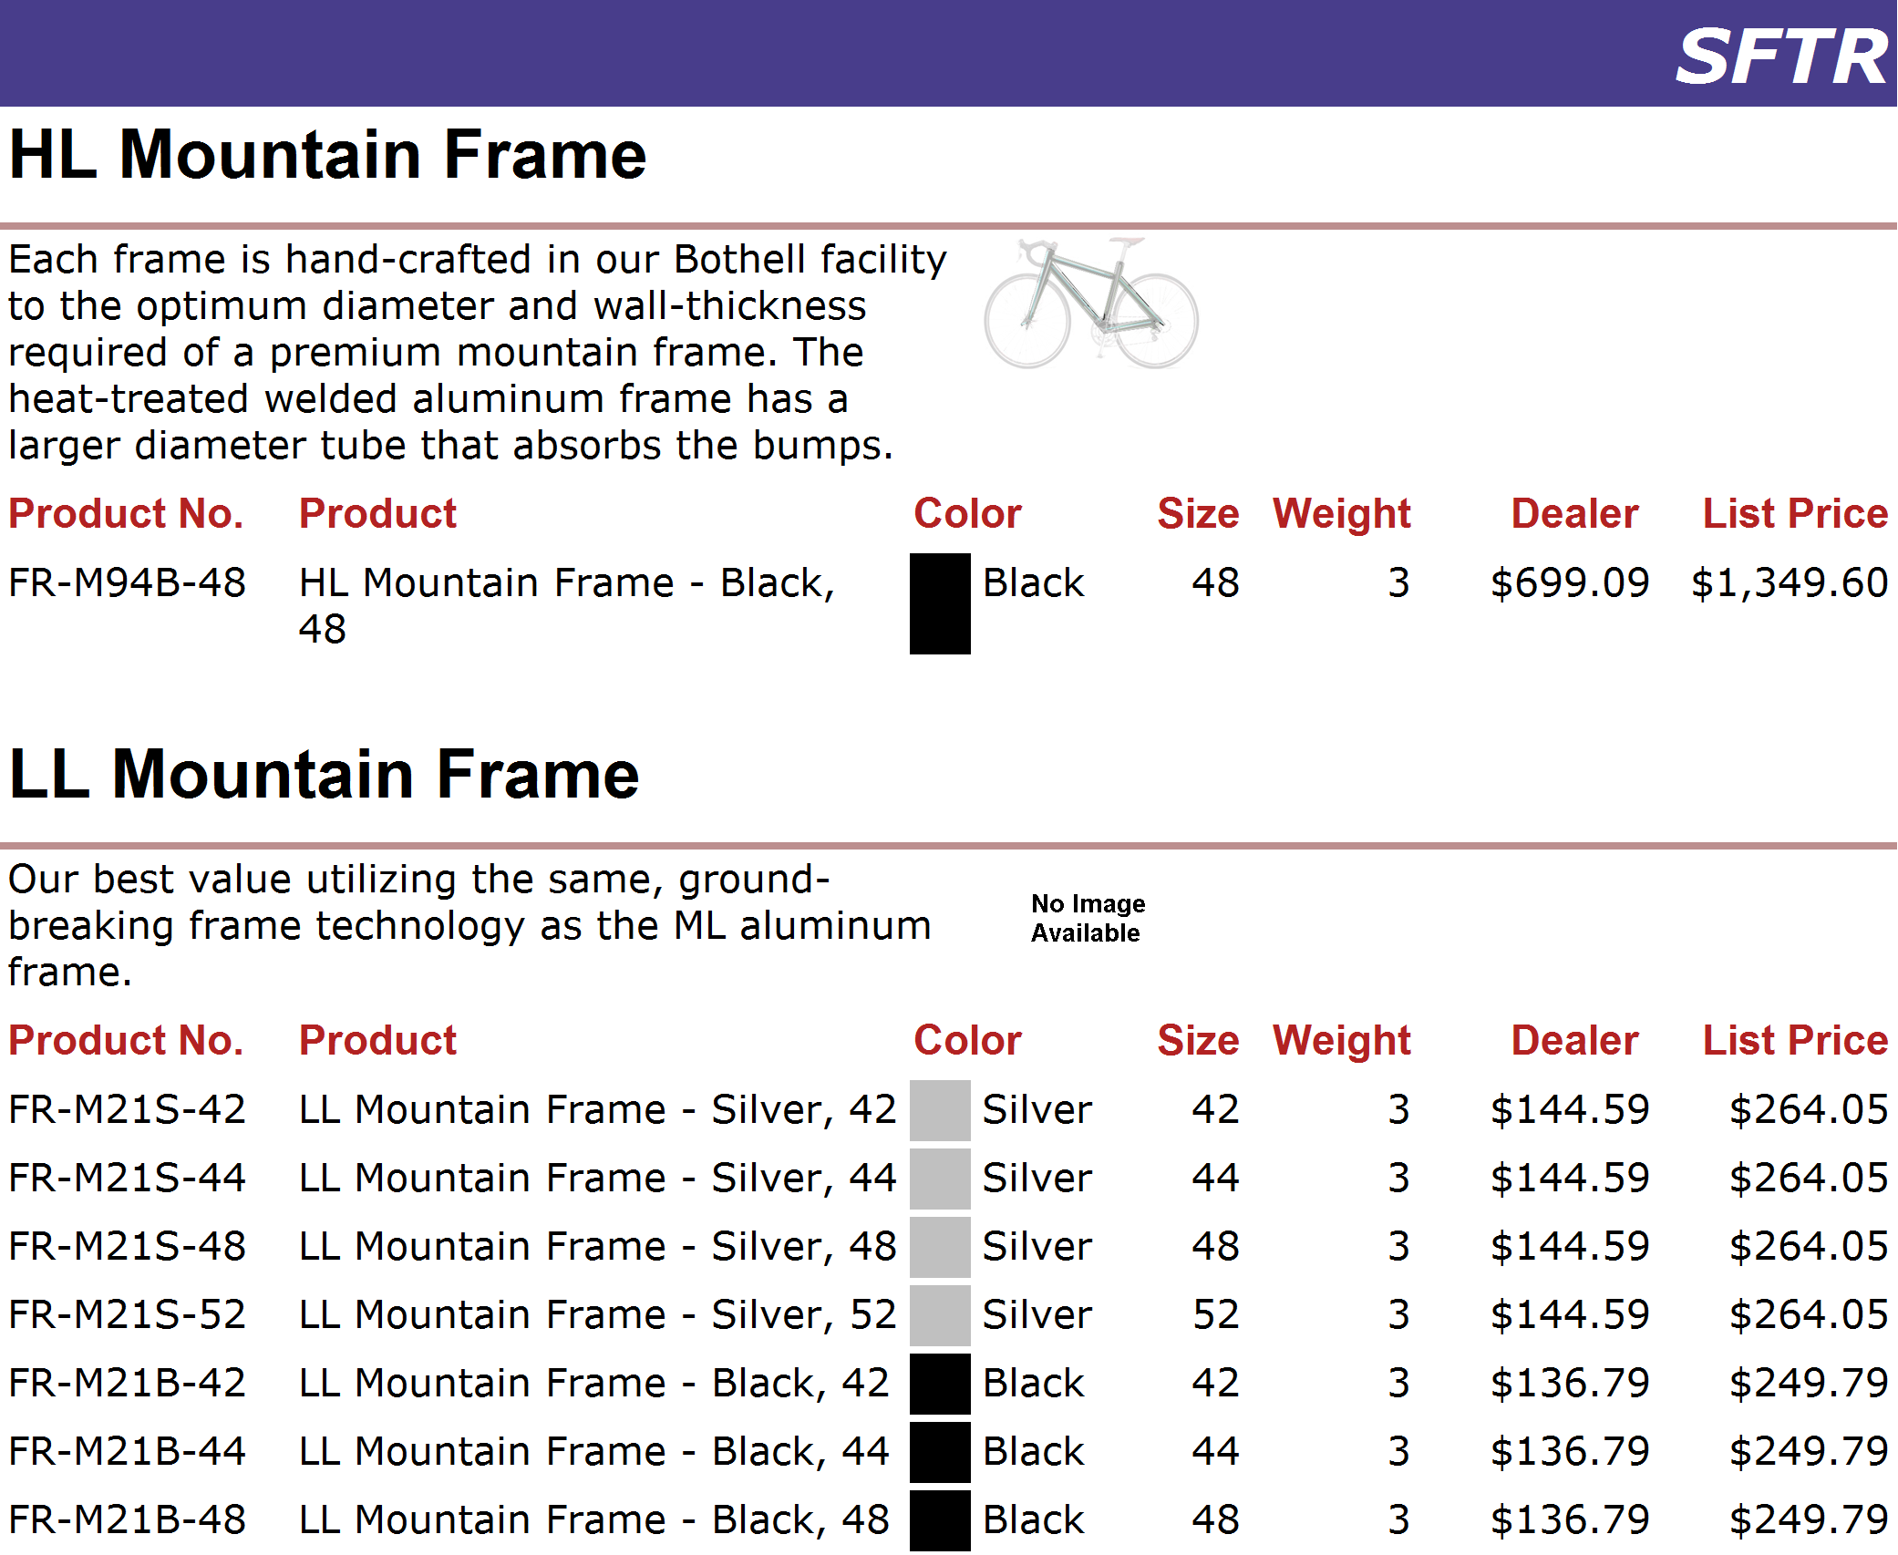
http://www.adventure-works.com
Page 44

Slide 45
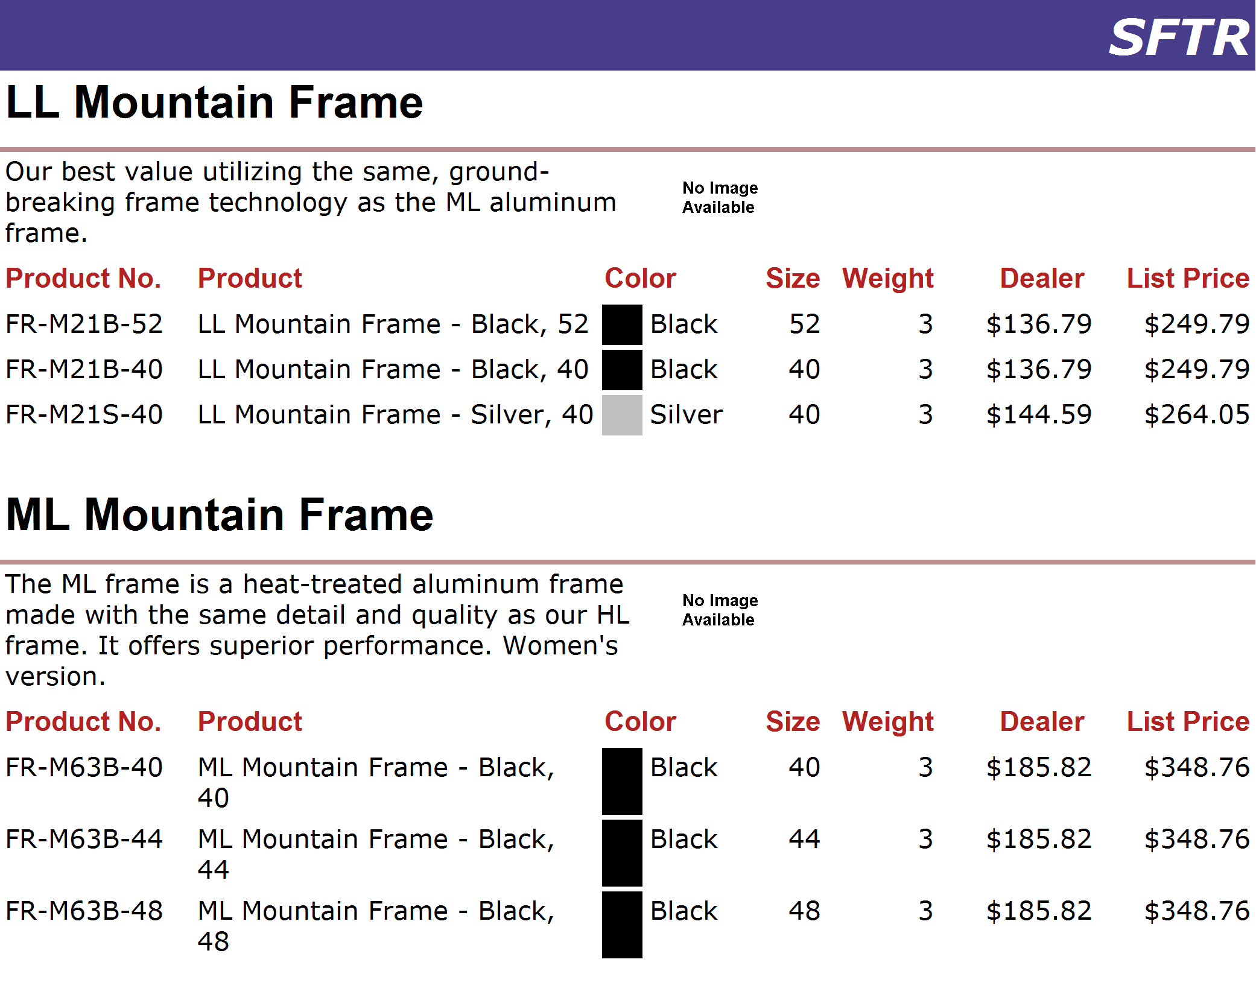
http://www.adventure-works.com
Page 45

Slide 46
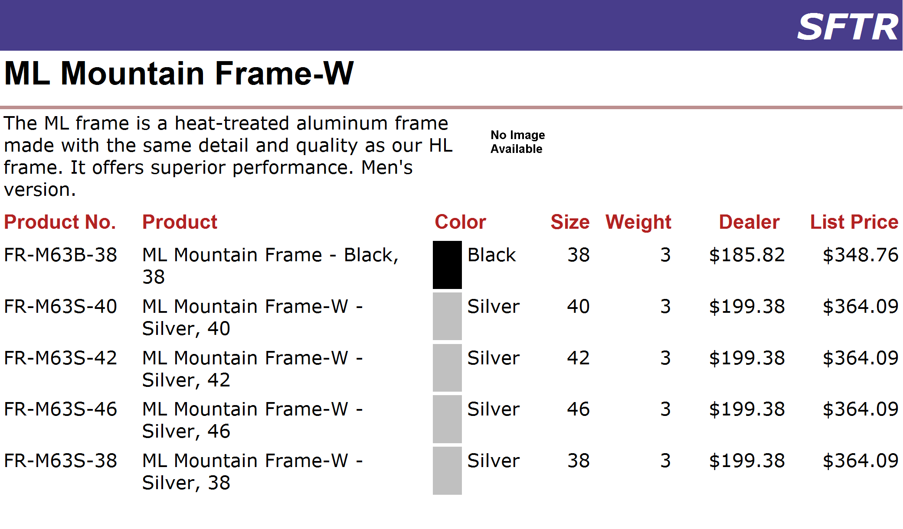
http://www.adventure-works.com
Page 46

Slide 47
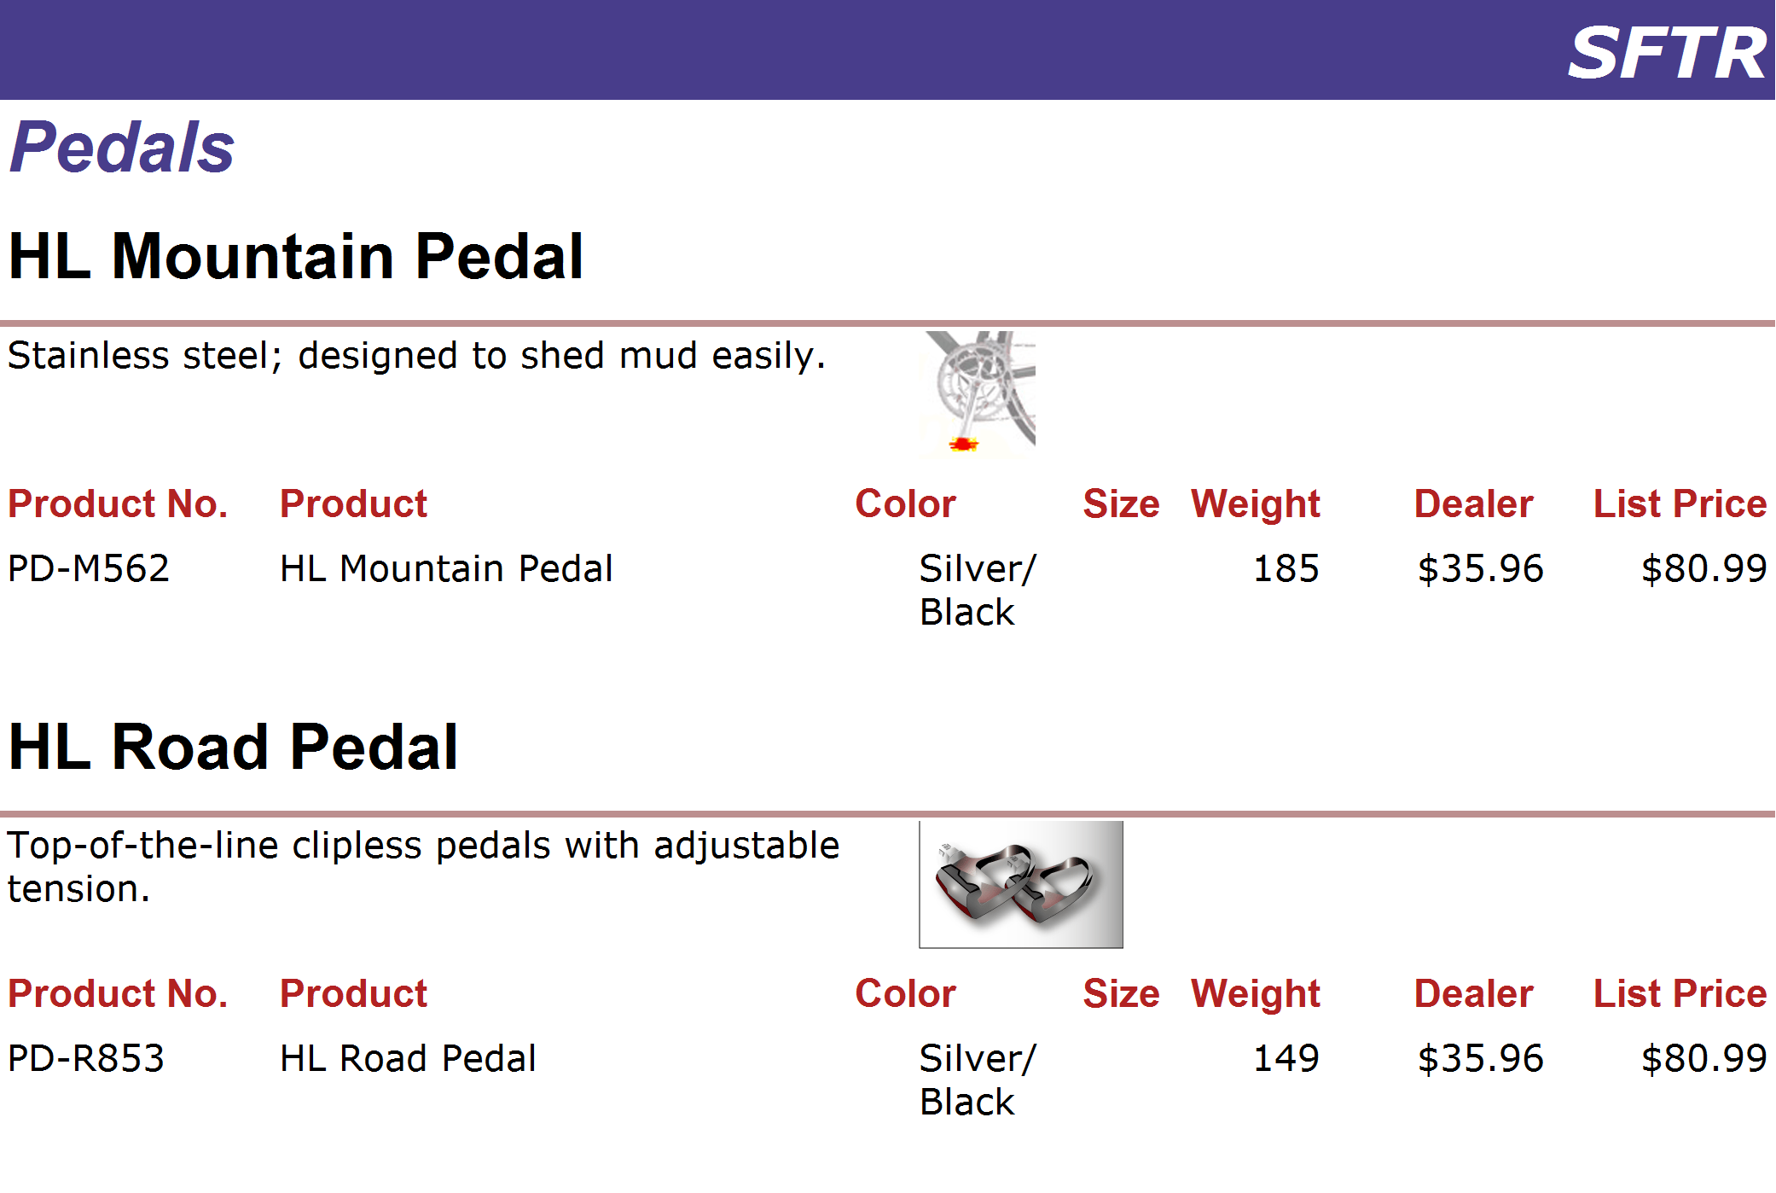
http://www.adventure-works.com
Page 47

Slide 48
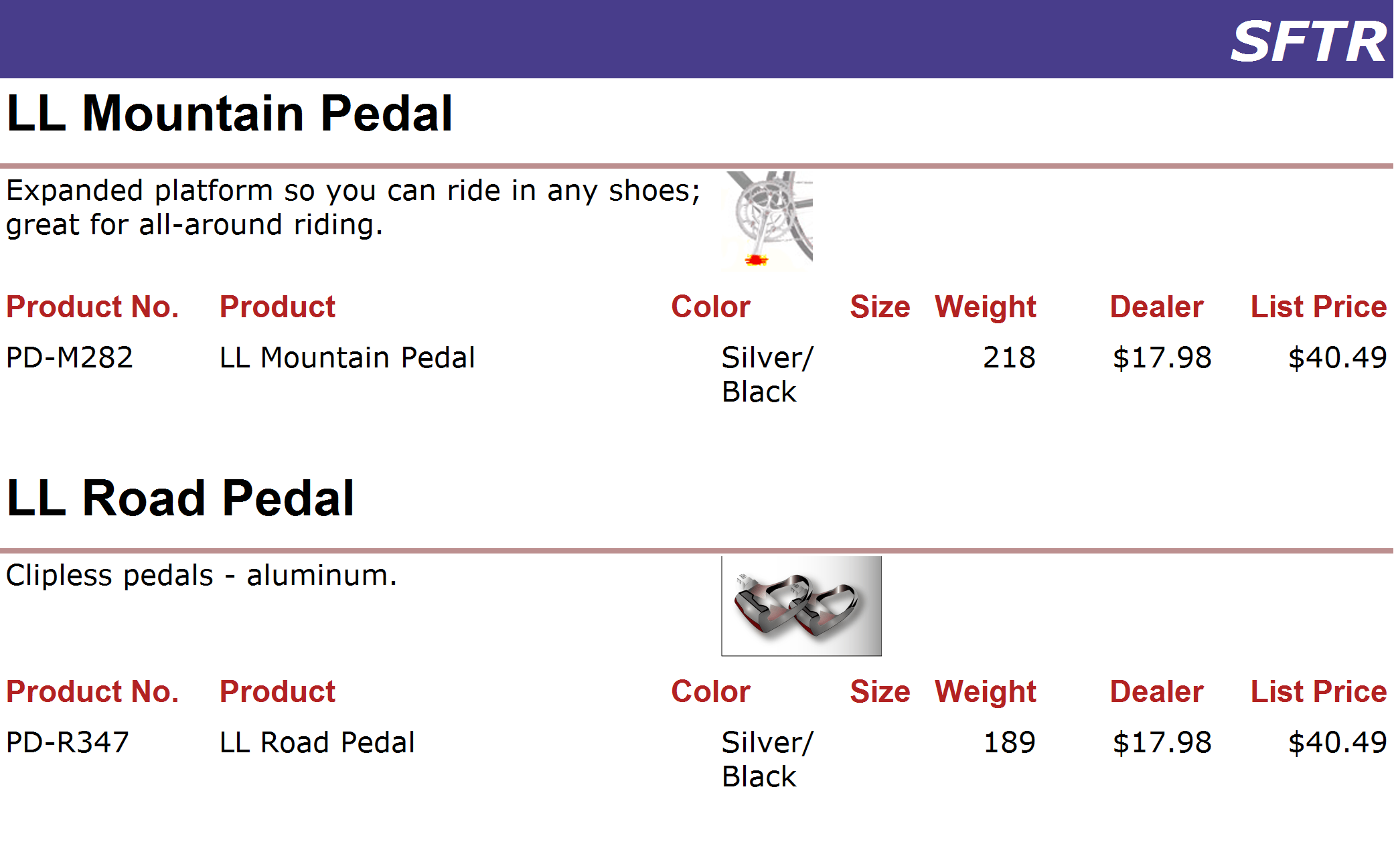
http://www.adventure-works.com
Page 48

Slide 49
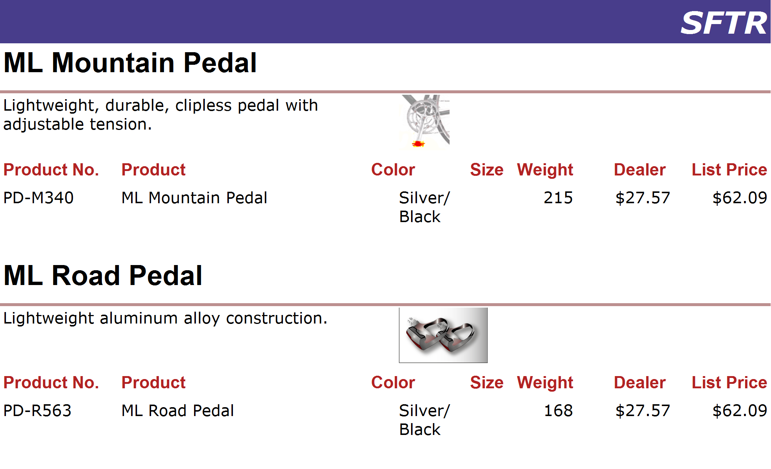
http://www.adventure-works.com
Page 49

Slide 50

http://www.adventure-works.com
Page 50

Slide 51

http://www.adventure-works.com
Page 51

Slide 52

http://www.adventure-works.com
Page 52

Slide 53

http://www.adventure-works.com
Page 53

Slide 54

http://www.adventure-works.com
Page 54

Slide 55

http://www.adventure-works.com
Page 55

Slide 56

http://www.adventure-works.com
Page 56

Slide 57

http://www.adventure-works.com
Page 57

Slide 58

http://www.adventure-works.com
Page 58

Slide 59

http://www.adventure-works.com
Page 59

Slide 60

http://www.adventure-works.com
Page 60

Slide 61

http://www.adventure-works.com
Page 61

Slide 62

http://www.adventure-works.com
Page 62

Slide 63

http://www.adventure-works.com
Page 63

Slide 64

http://www.adventure-works.com
Page 64

